Slide 1
Longleaf Pine Establishment
Mark Bost, Assistant Regional Forester
NC Forest Service

Slide 3
Another Range Map for NC:

Slide 7
1997 – 2006 Longleaf Pine Establishment
For Private Land in NC
Longleaf Pine Established Under Federal & State Cost-Share Programs in NC by DFR District
Acres | District | Percent
20,685 | 6 | 34.84
19,081 | 3 | 32.14
14,475 | 8 | 24.38
3,155 | 4 | 5.31
1,314 | 5 | 2.21
419 | 7 | 0.71
104 | 11 | 0.18
85 | 10 | 0.14
42 | 13 | 0.07
6 | 2 | 0.01
1 | 12 | 0.00
- | 1 | -
- | 9 | -
59367

Slide 8
Area of Timberland by Forest-Type Group
Million acres
Spruce-fir
White-red-jack
Long-
leaf-
slash
Loblolly-shortleaf
Oak- pine
Oak- hickory
Oak-gum-cypress
Elm-ash-cotton-wood
Maple-beech-birch
Non-stocked
Forest-type group

Slide 9
Longleaf in Cutovers usually a slam dunk

Slide 10
Agricultural Field Challenges
Everything the farmer did to make the field better
for growing crops made it worse for growing
Longleaf pine
Why?
If Longleaf will be planted immediately following
agricultural crop it is normally best to lay out the
field for 1 year

Slide 11
Test pH
“Before applying any herbicide over longleaf pine it is
important to test the soil pH. One of the most popular
herbicides (Oust/sulfometuron) becomes more active
as soil pH increases. If soil is above 6.0 pH, Oust should
only be applied at the lowest recommended rate. If the
soil is above 6.5 pH, do not apply more than 1 oz of Oust
to the acre. If the soil is above 6.7, Oust should probably
be avoided on these soils.”

Slide 12
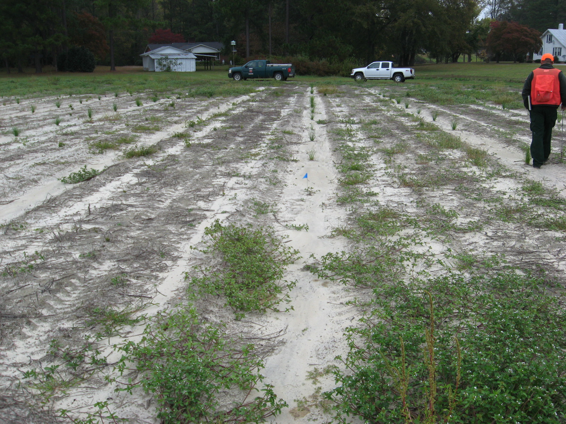
Fall after scalp, plant, Arsenal/Oust
(Greene County)

Slide 13
Grass and longleaf = failure
Site prep bermuda and fescue fields with
well timed herbicide application per literature
Only apply Arsenal or Oust/Oustar over the top
of longleaf pine when you are in danger of
loosing the stand

Slide 14
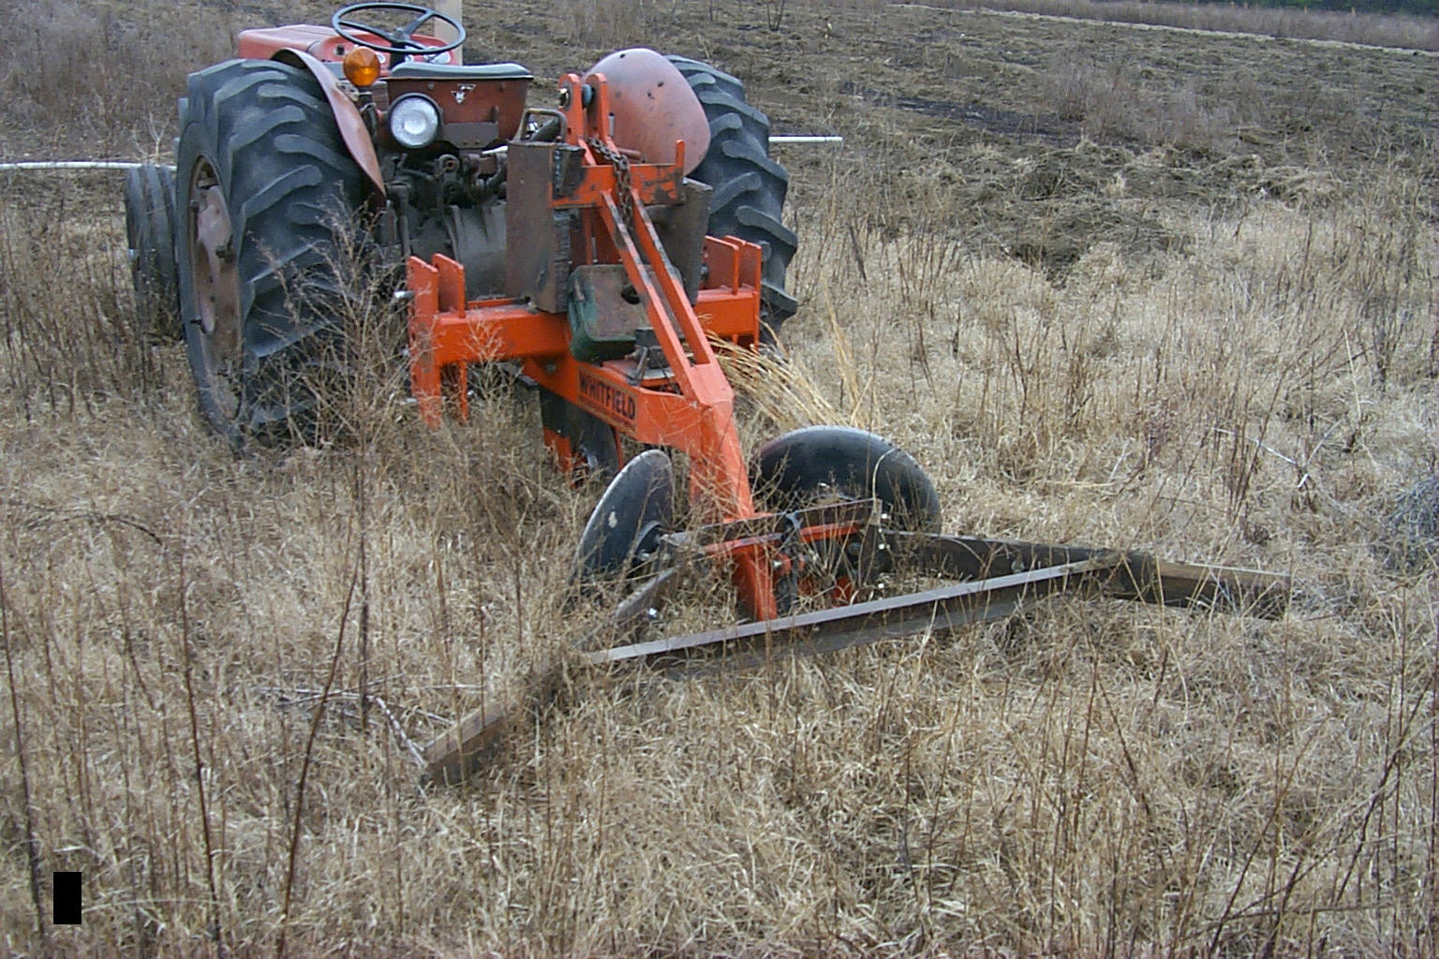
Scalp early if possible (late August through early October)

Slide 15
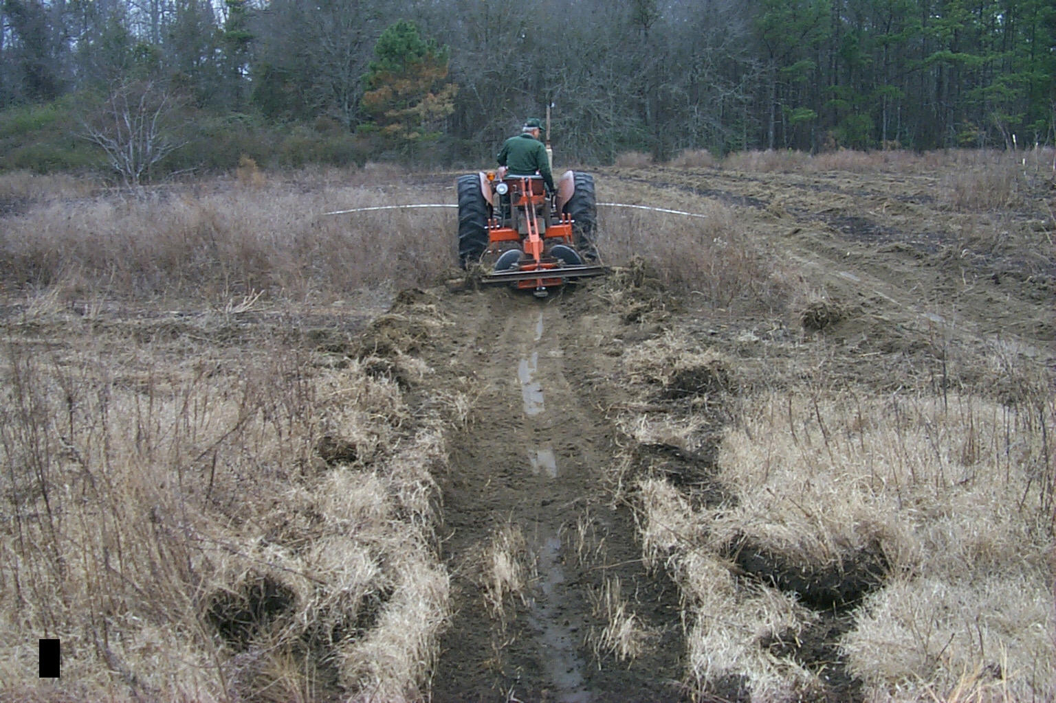

Slide 16
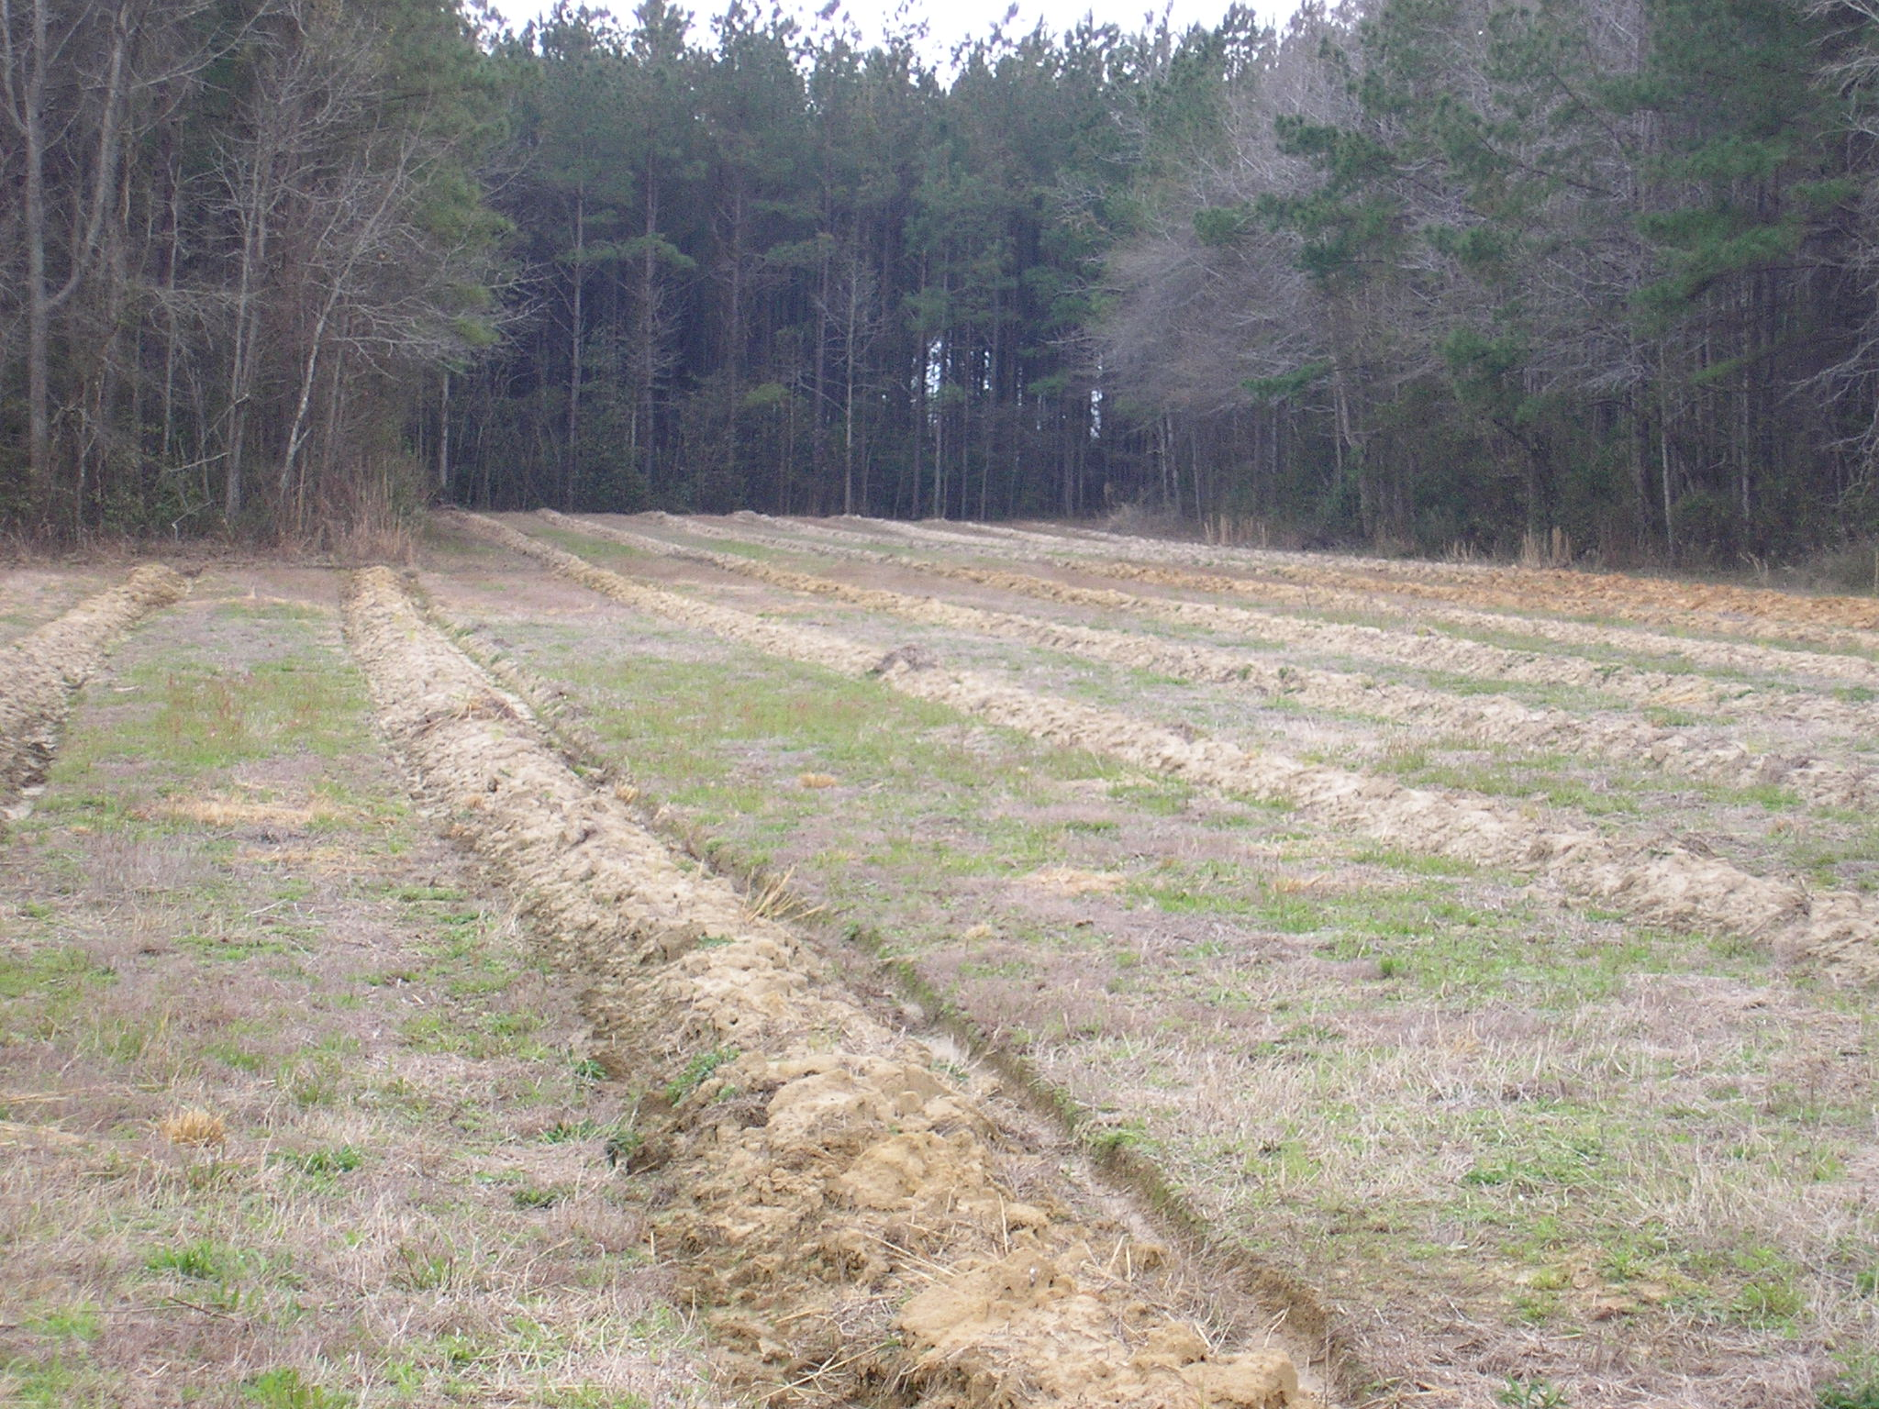
Bedding sometimes helps

Slide 17
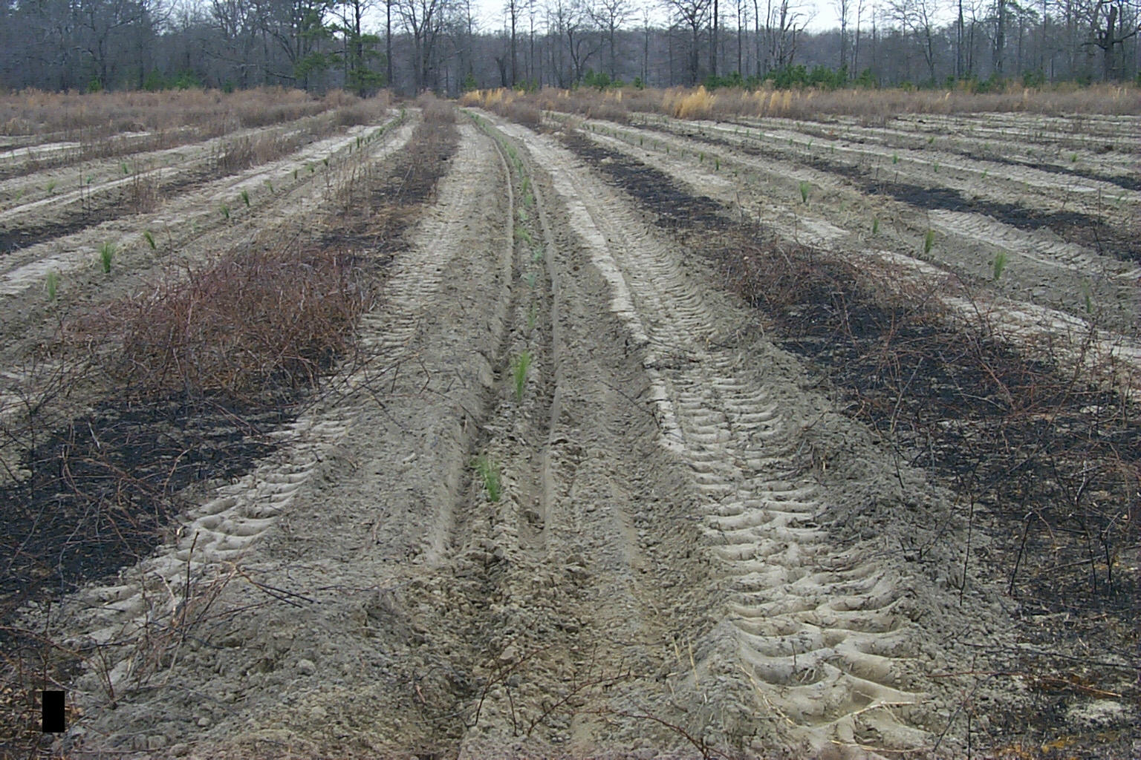
Machine Planting bare root is an option
(trees must have very recent lift date)

Slide 18
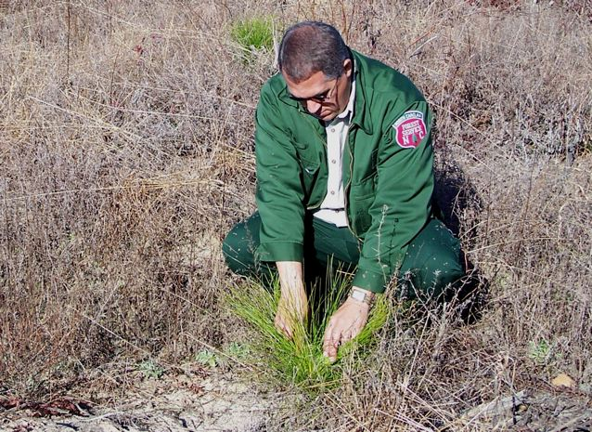
Maintenance is Important!
Check competition and survival often the first 2 years

Slide 19
If there are any mature loblolly pine
surrounding the field, make sure LO
is prepared to fight natural loblolly
pine competition.
Mowing and mechanical are both
options in open fields (scalping makes
finding rows of planted longleaf easier)

Slide 20
The Problem:

Slide 21
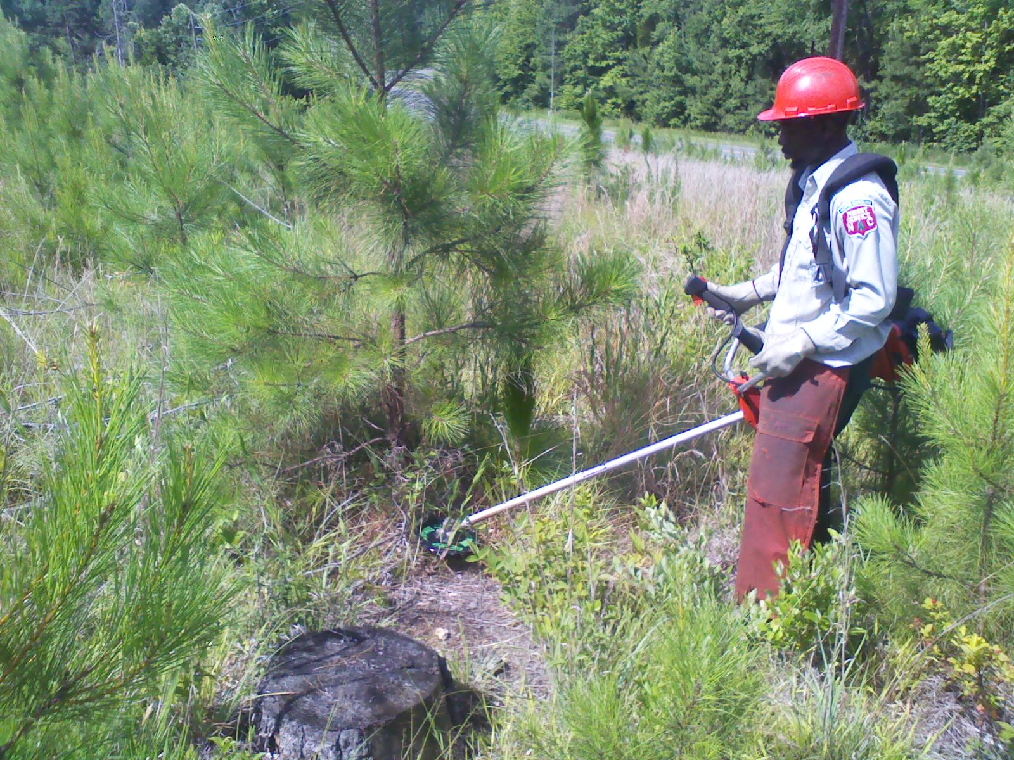
The Solution:

Slide 22
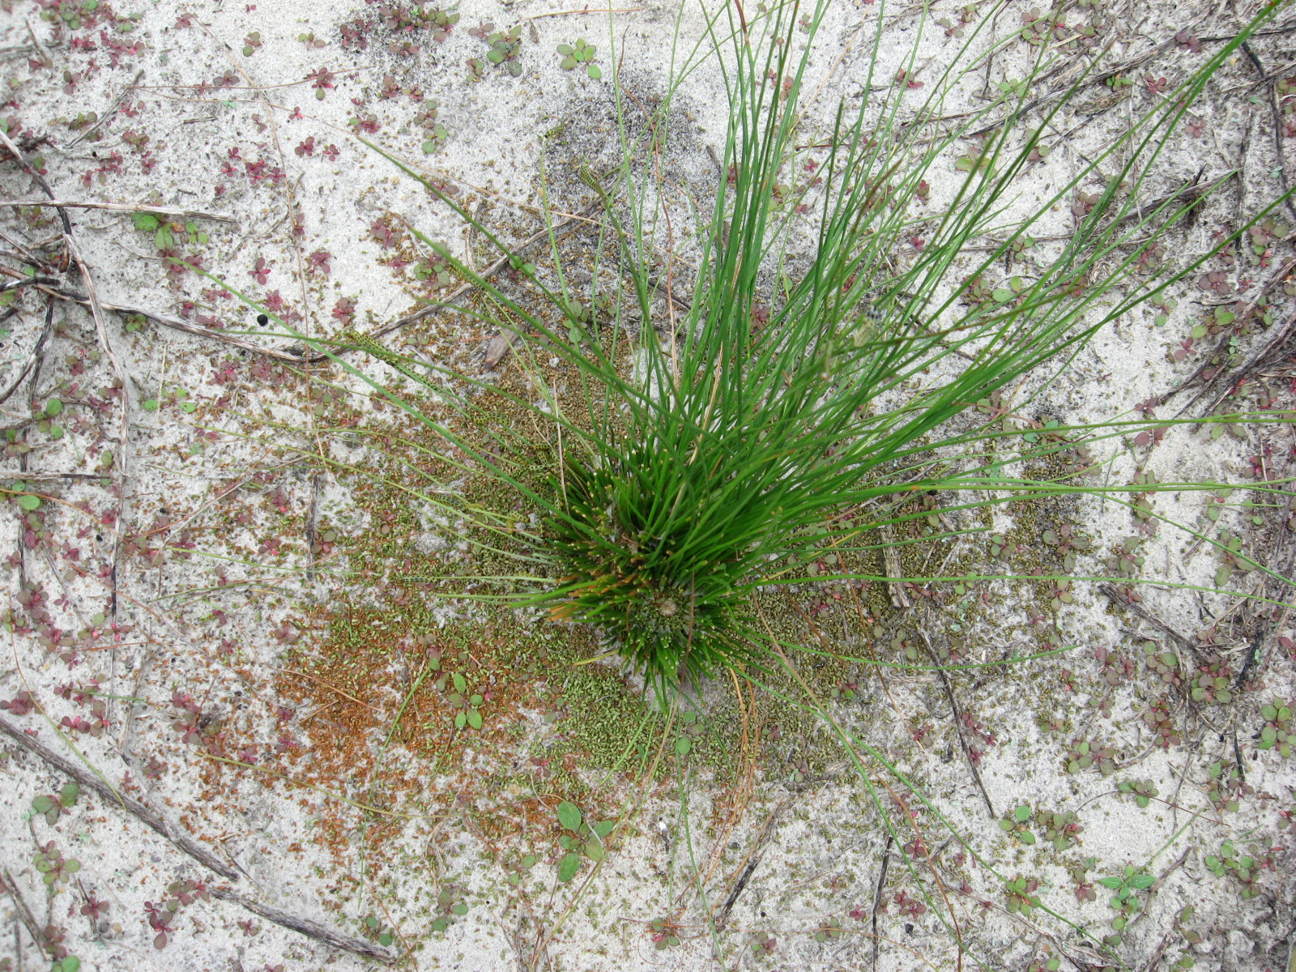

Slide 24
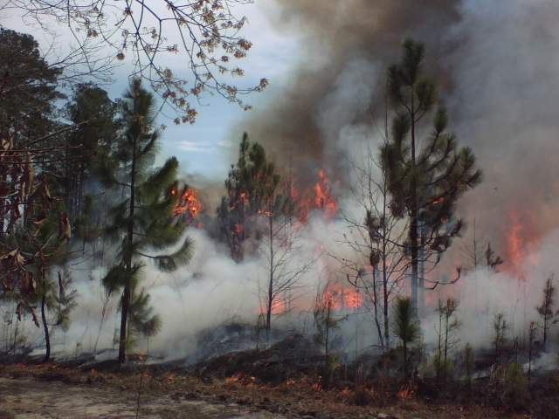
Longleaf Pine required “Maintenance” by Fire
(Wake County Harris Lake Park Longleaf Burn 4-08)

Slide 25
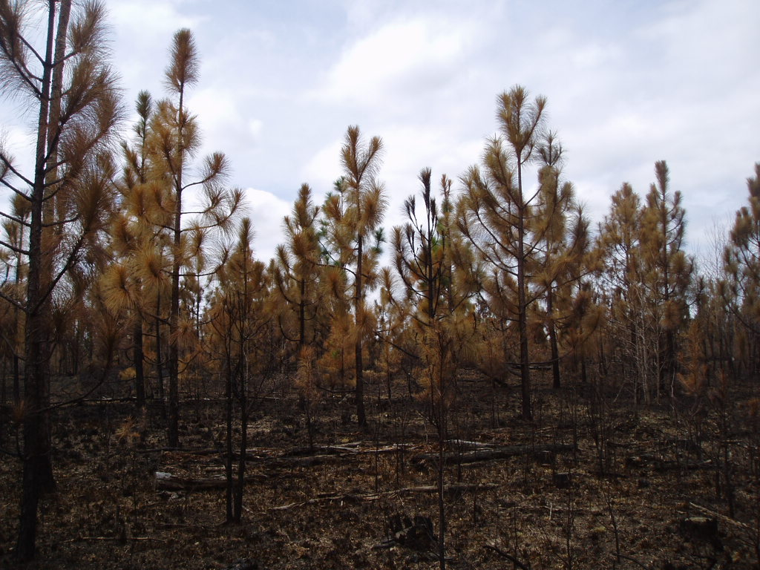

Slide 26
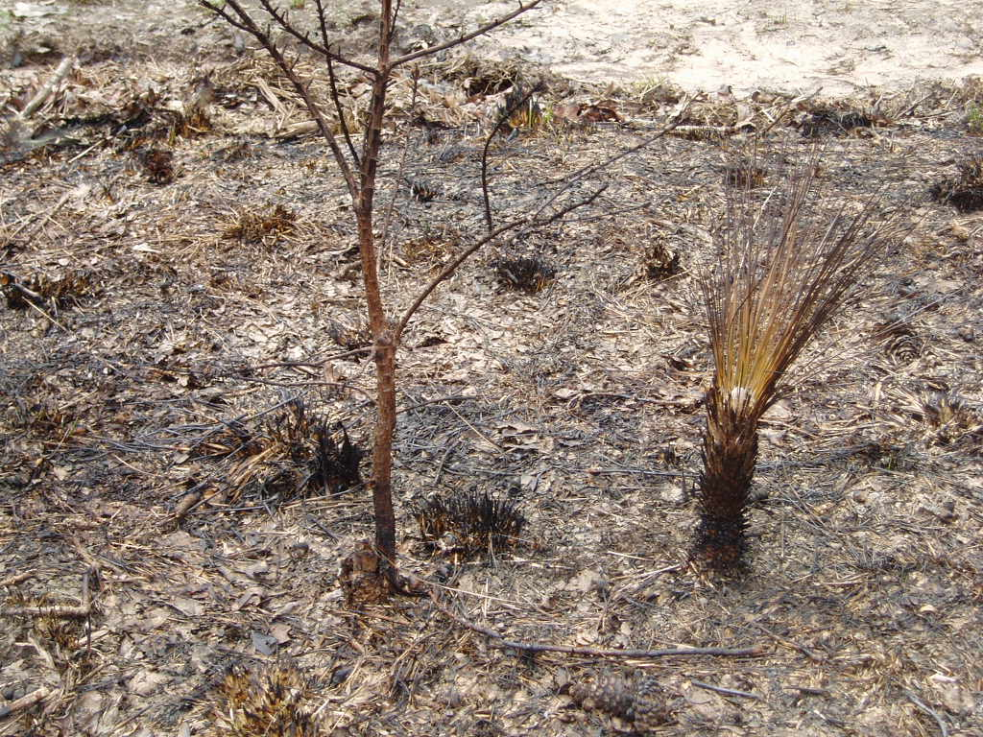

Slide 27
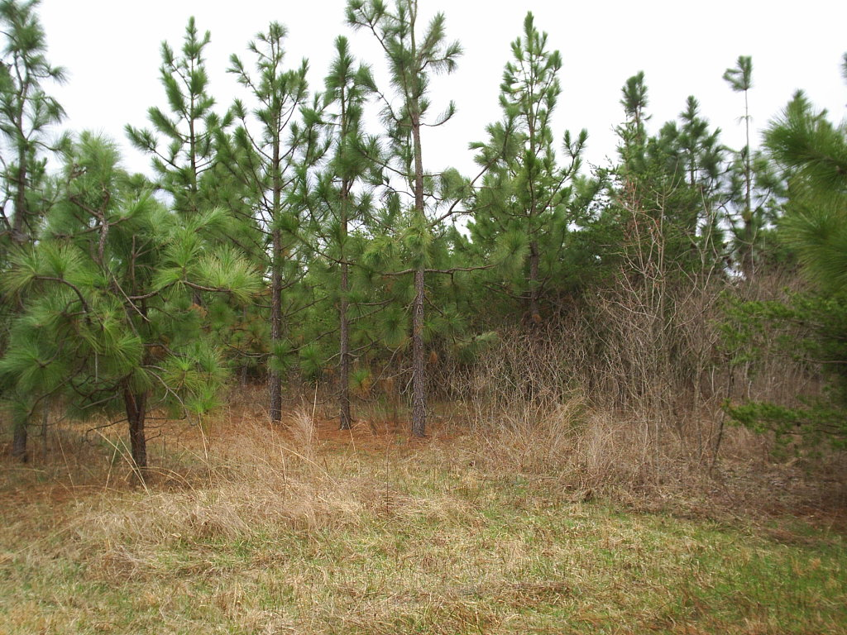
Northern Alamance Co. Longleaf Pine- 11 yrs old

Slide 28
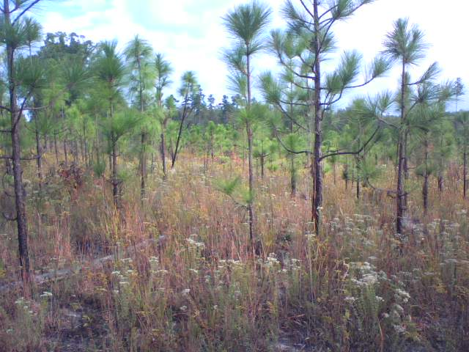
Harnett Co. Longleaf Pine

Slide 29
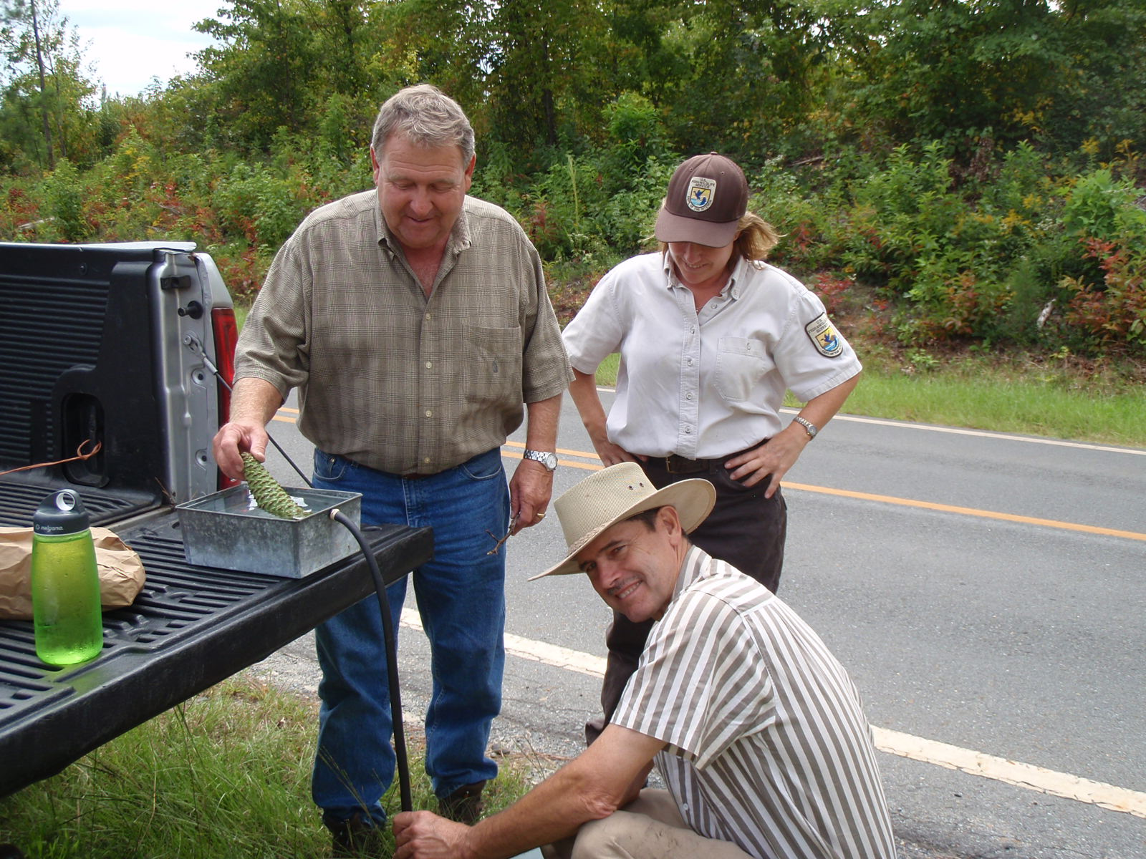
Laura Fogo’s Montgomery County Restoration Project

Slide 30
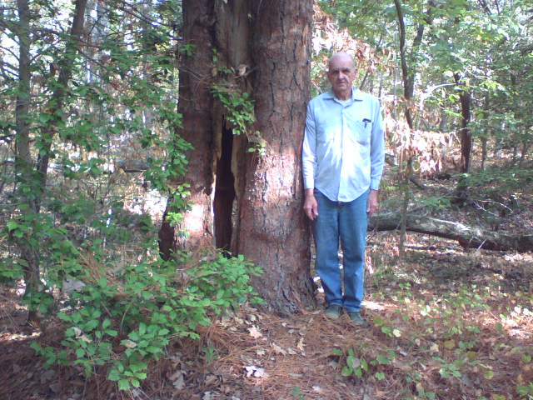
Old Relic Longleaf Pine in Montgomery County

Slide 31
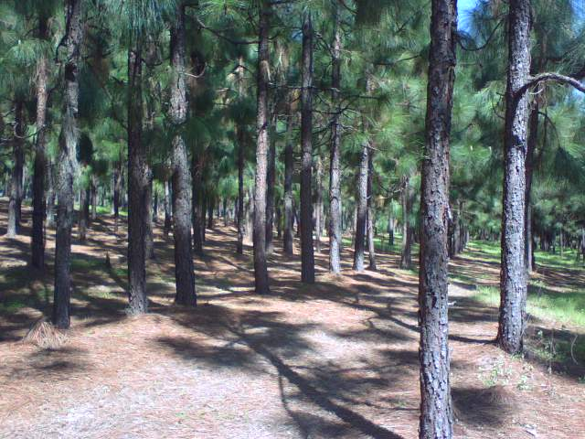
Yadkin Co. Longleaf Pine with Big Problems!

Slide 32
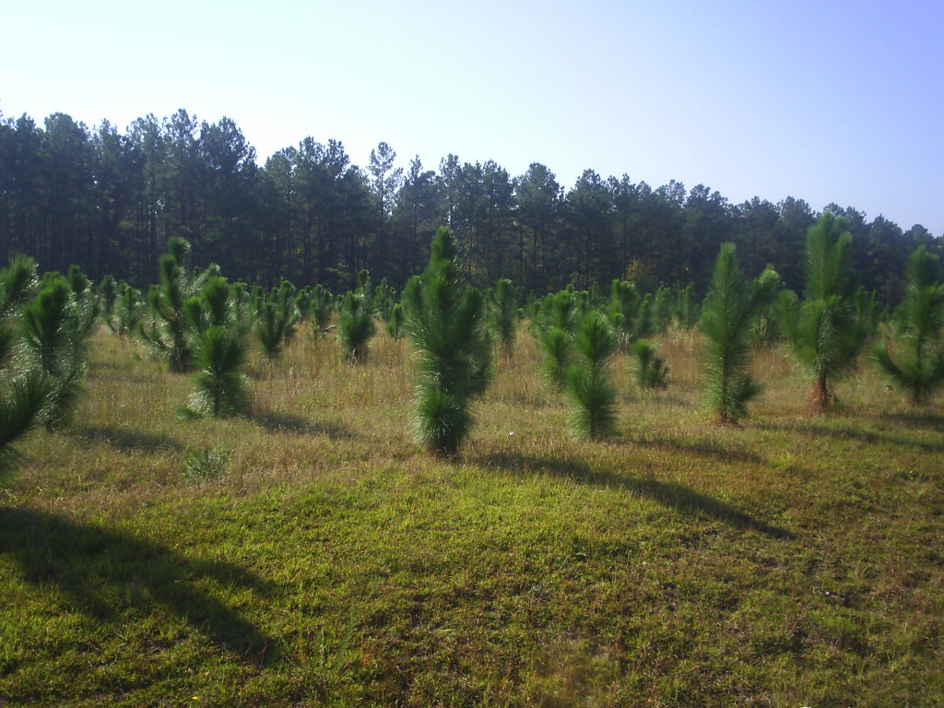
Johnston County CRP

Slide 33
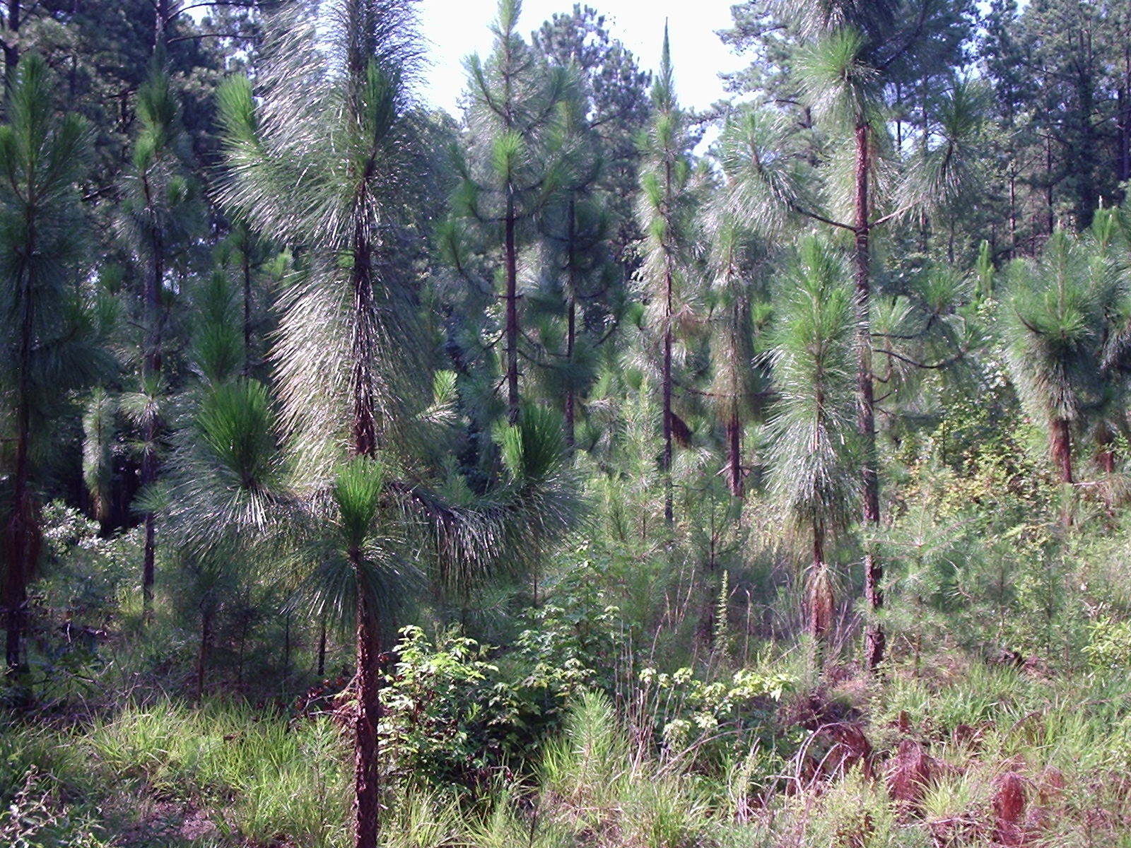
Nine year old longleaf pine at Jordan Lake average 1 -2 feet less
height growth than loblolly pine planted on same site

Slide 34
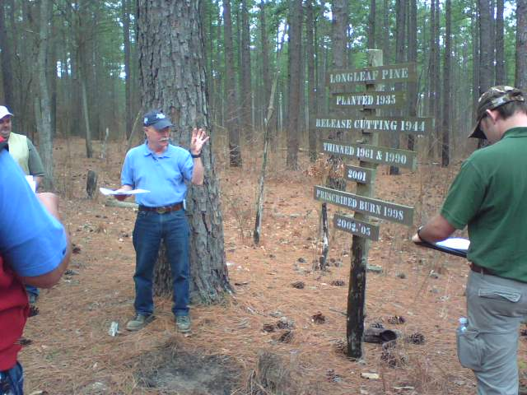
Durham County Longleaf Pine (77 years old)

Slide 35
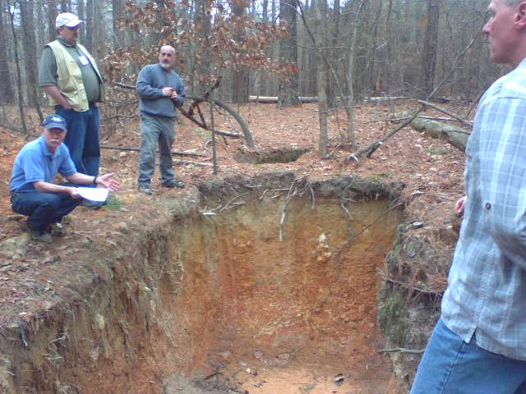

Slide 36
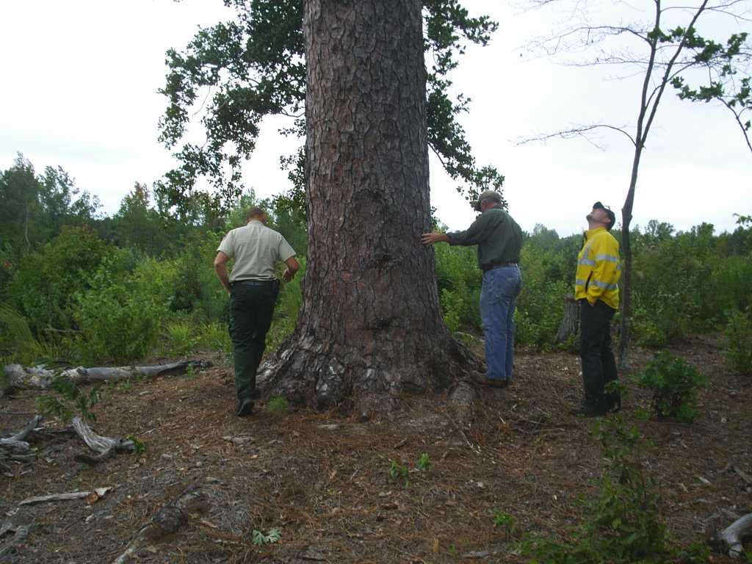
Current State Record is old line tree in Montgomery Co.

Slide 37
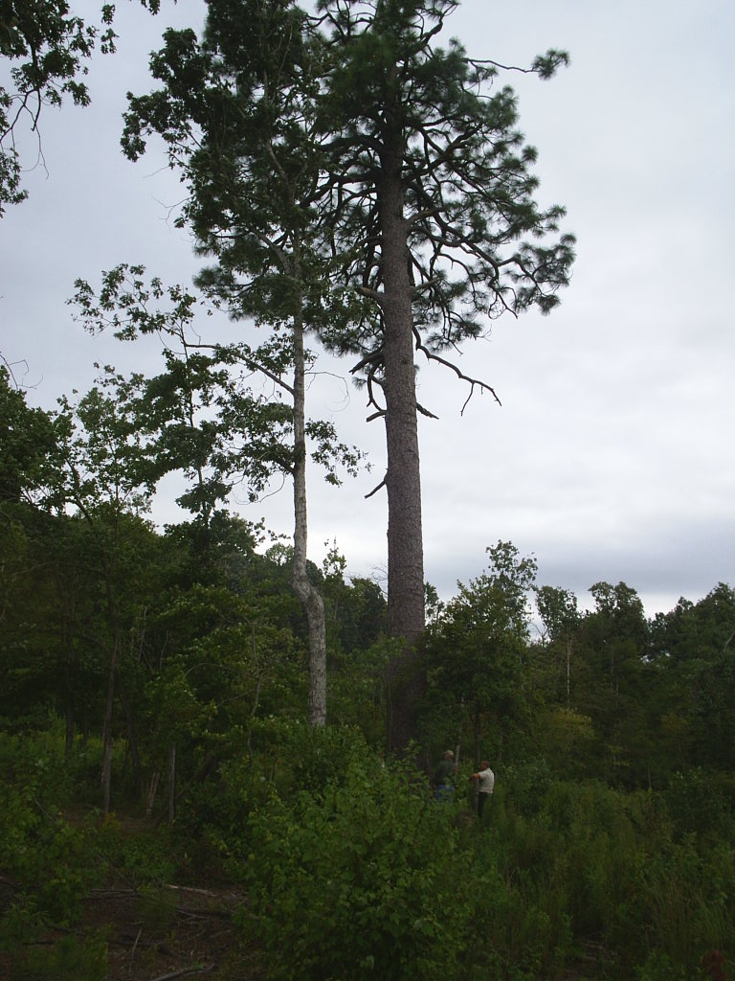
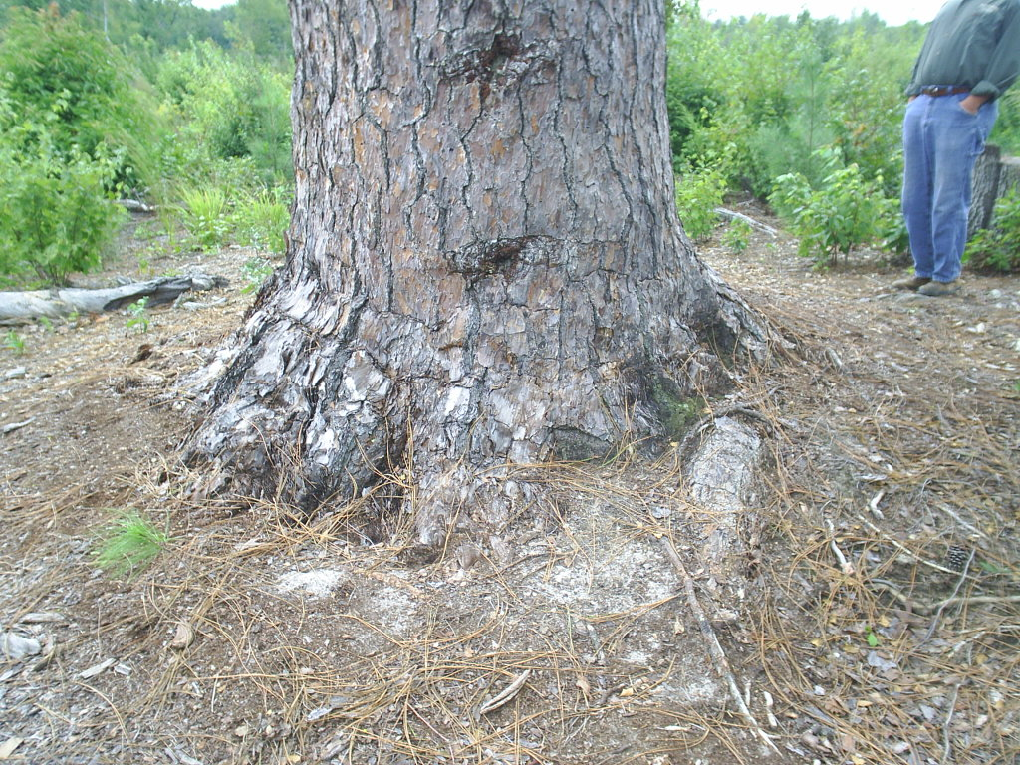
Another view of the
current state record
longleaf pine

Slide 38
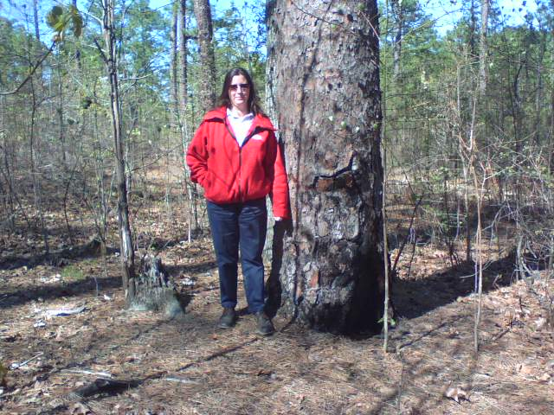
North Carolina’s oldest longleaf pine (Weymouth Woods)

Slide 39
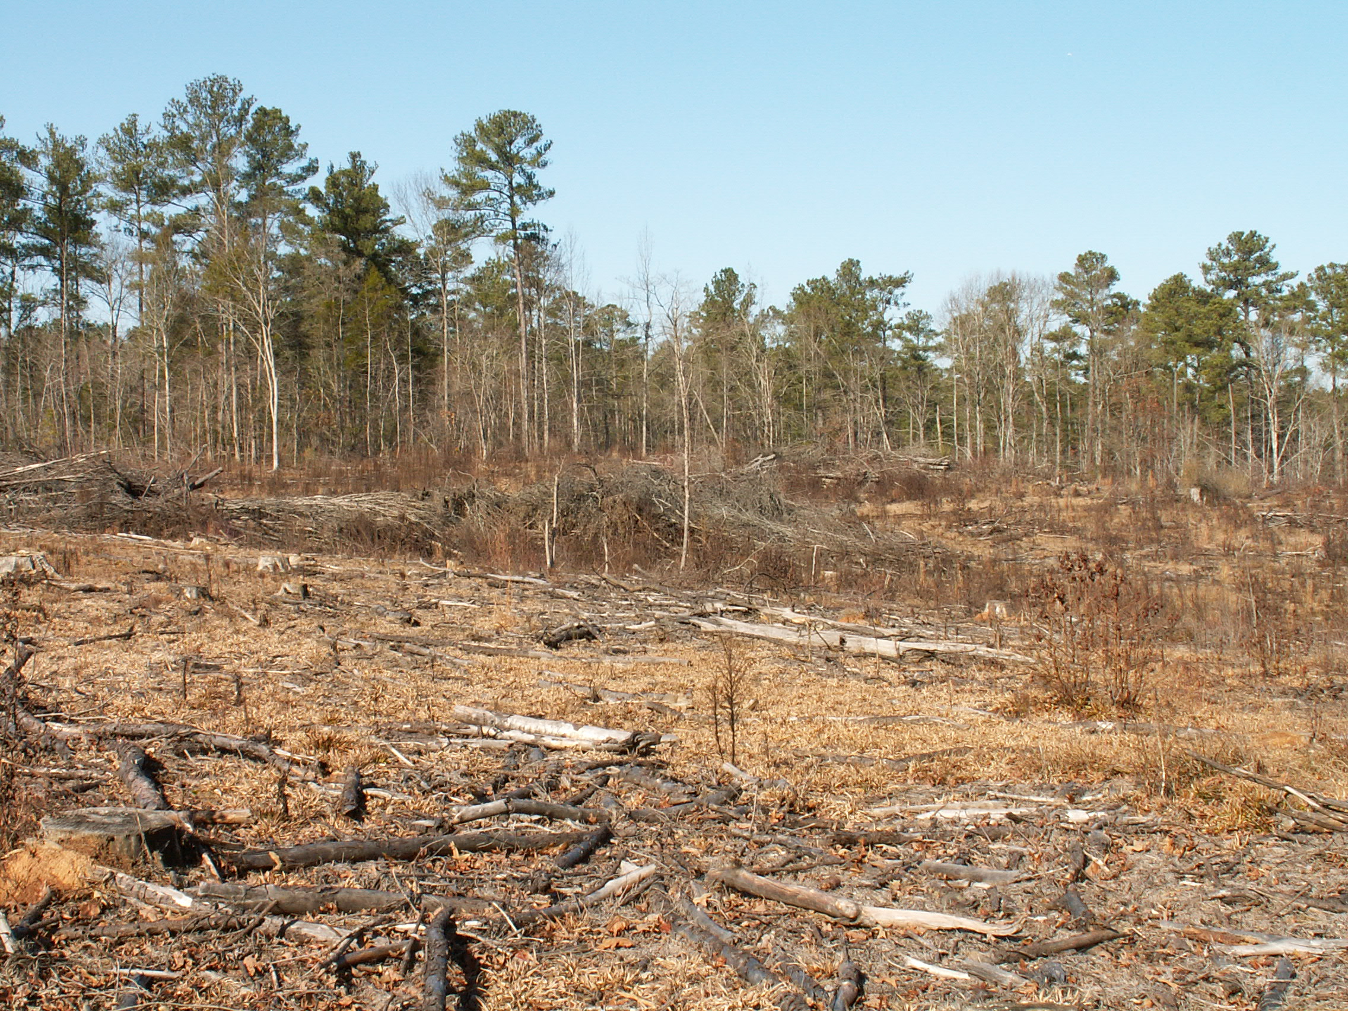
Chatham County “Before”

Slide 40
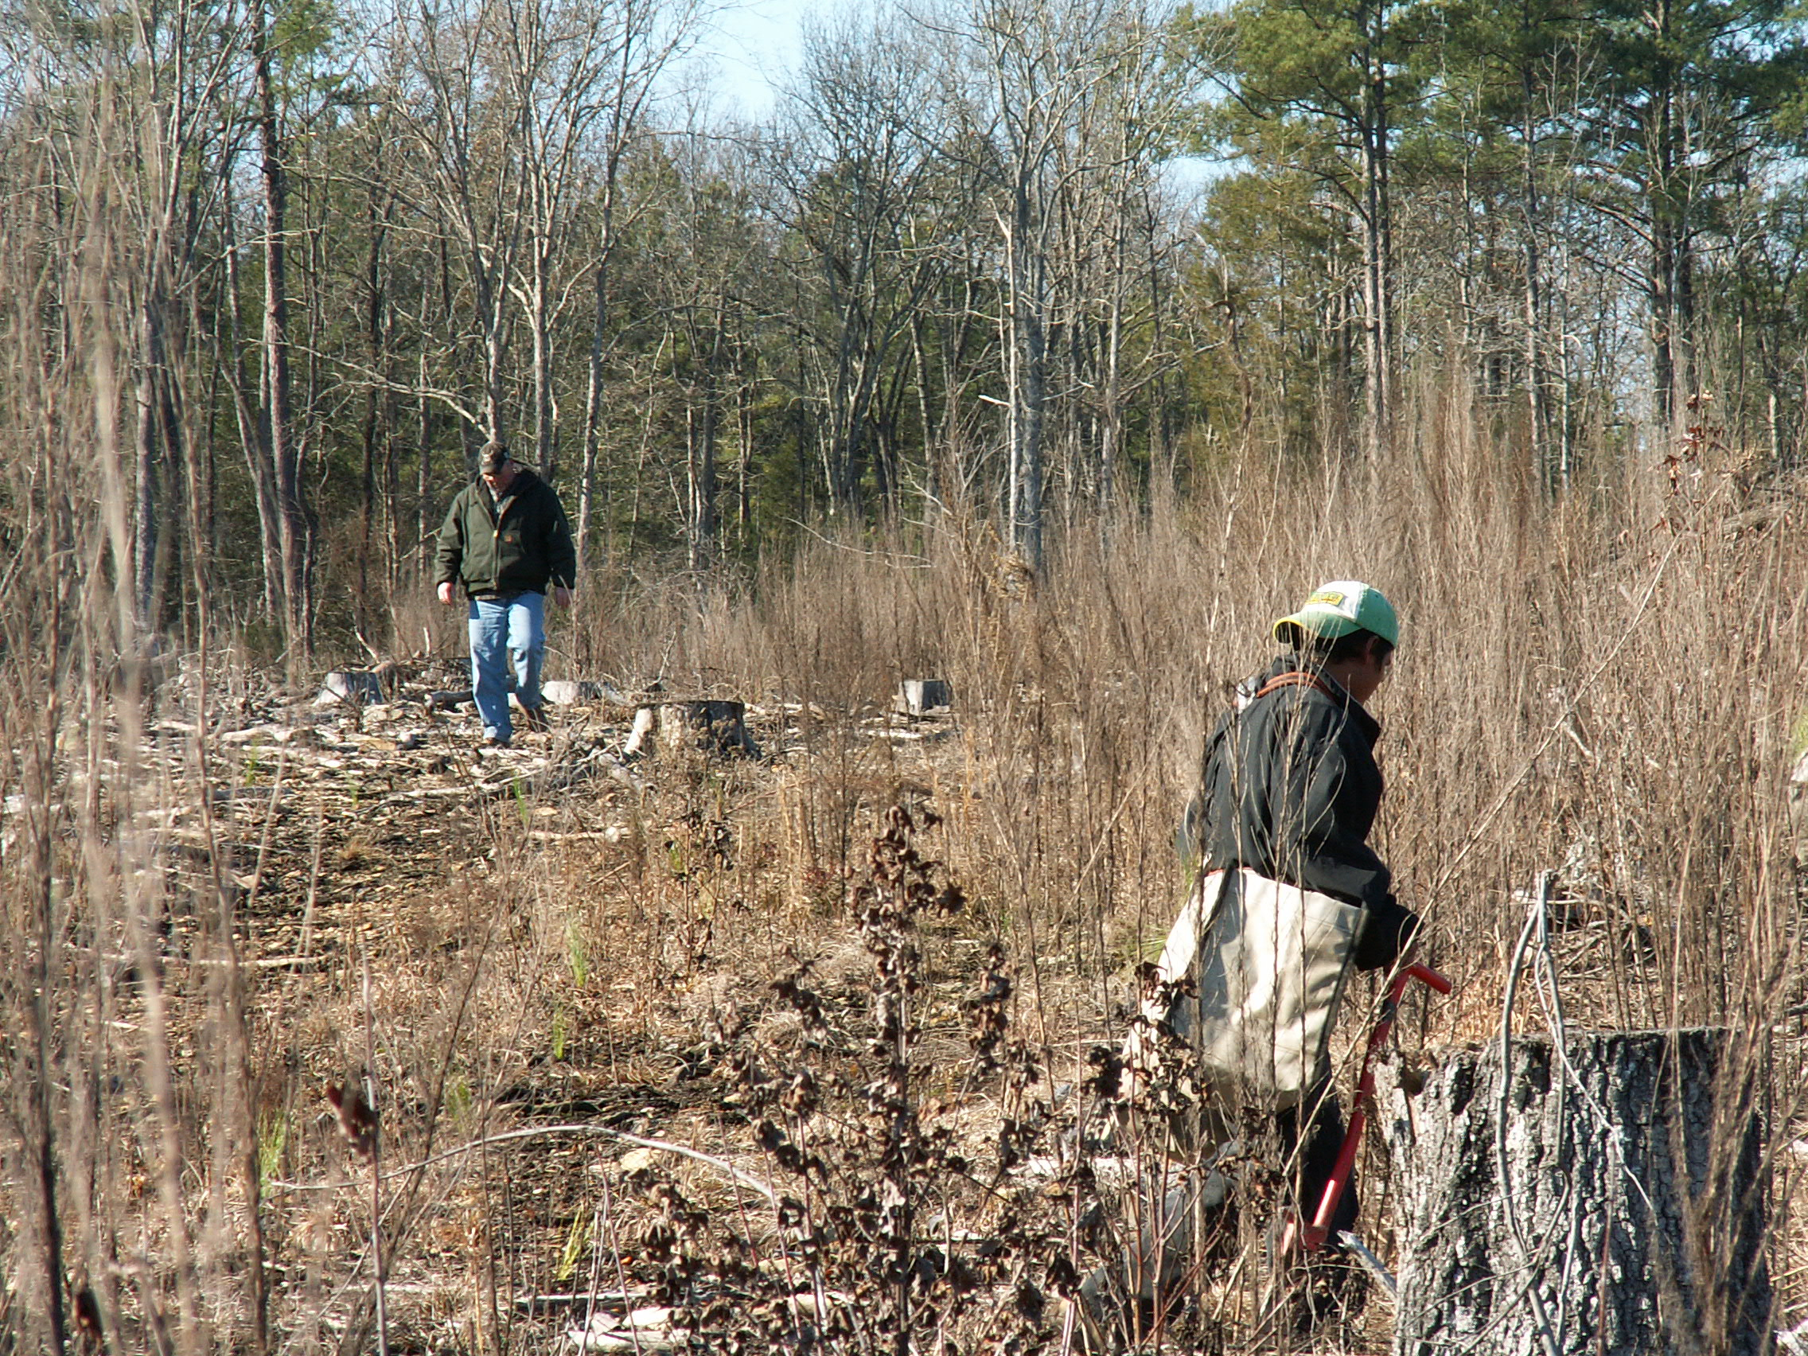
Chatham County “During” (December 22, 2009)

Slide 41
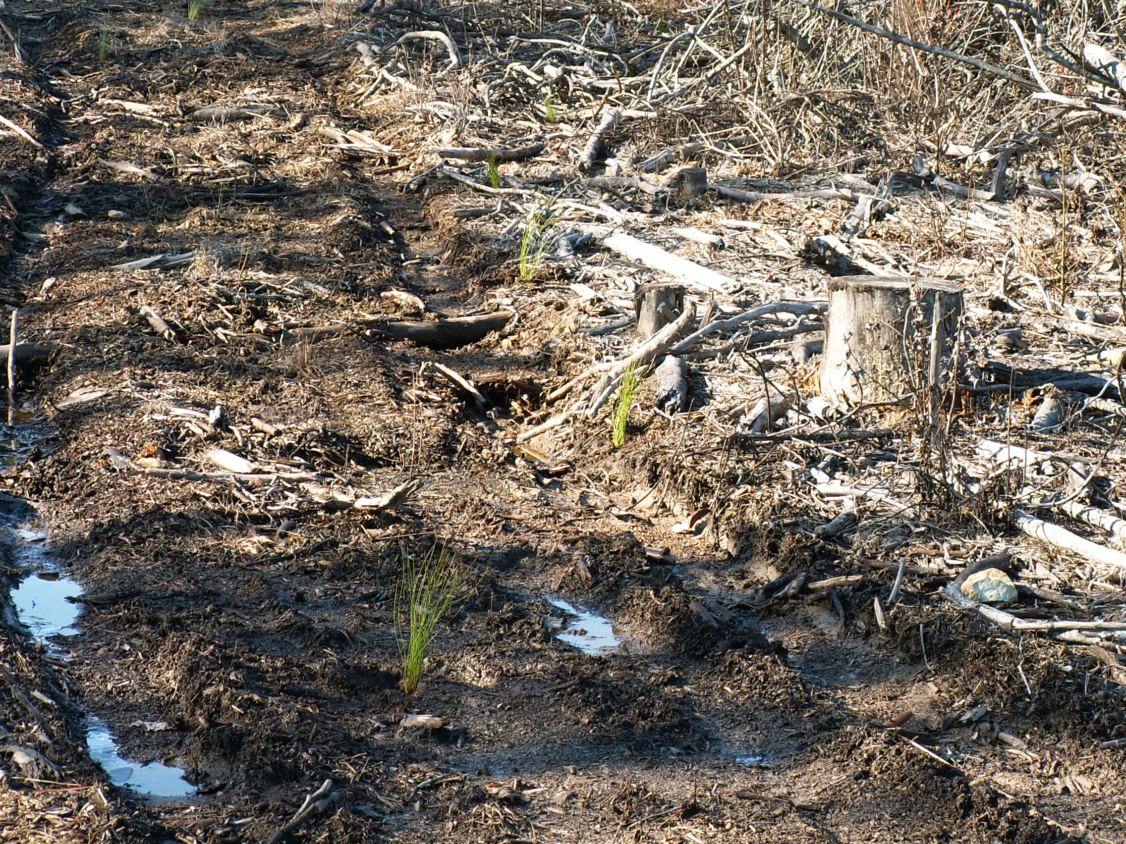
Chatham County “After”

Slide 42
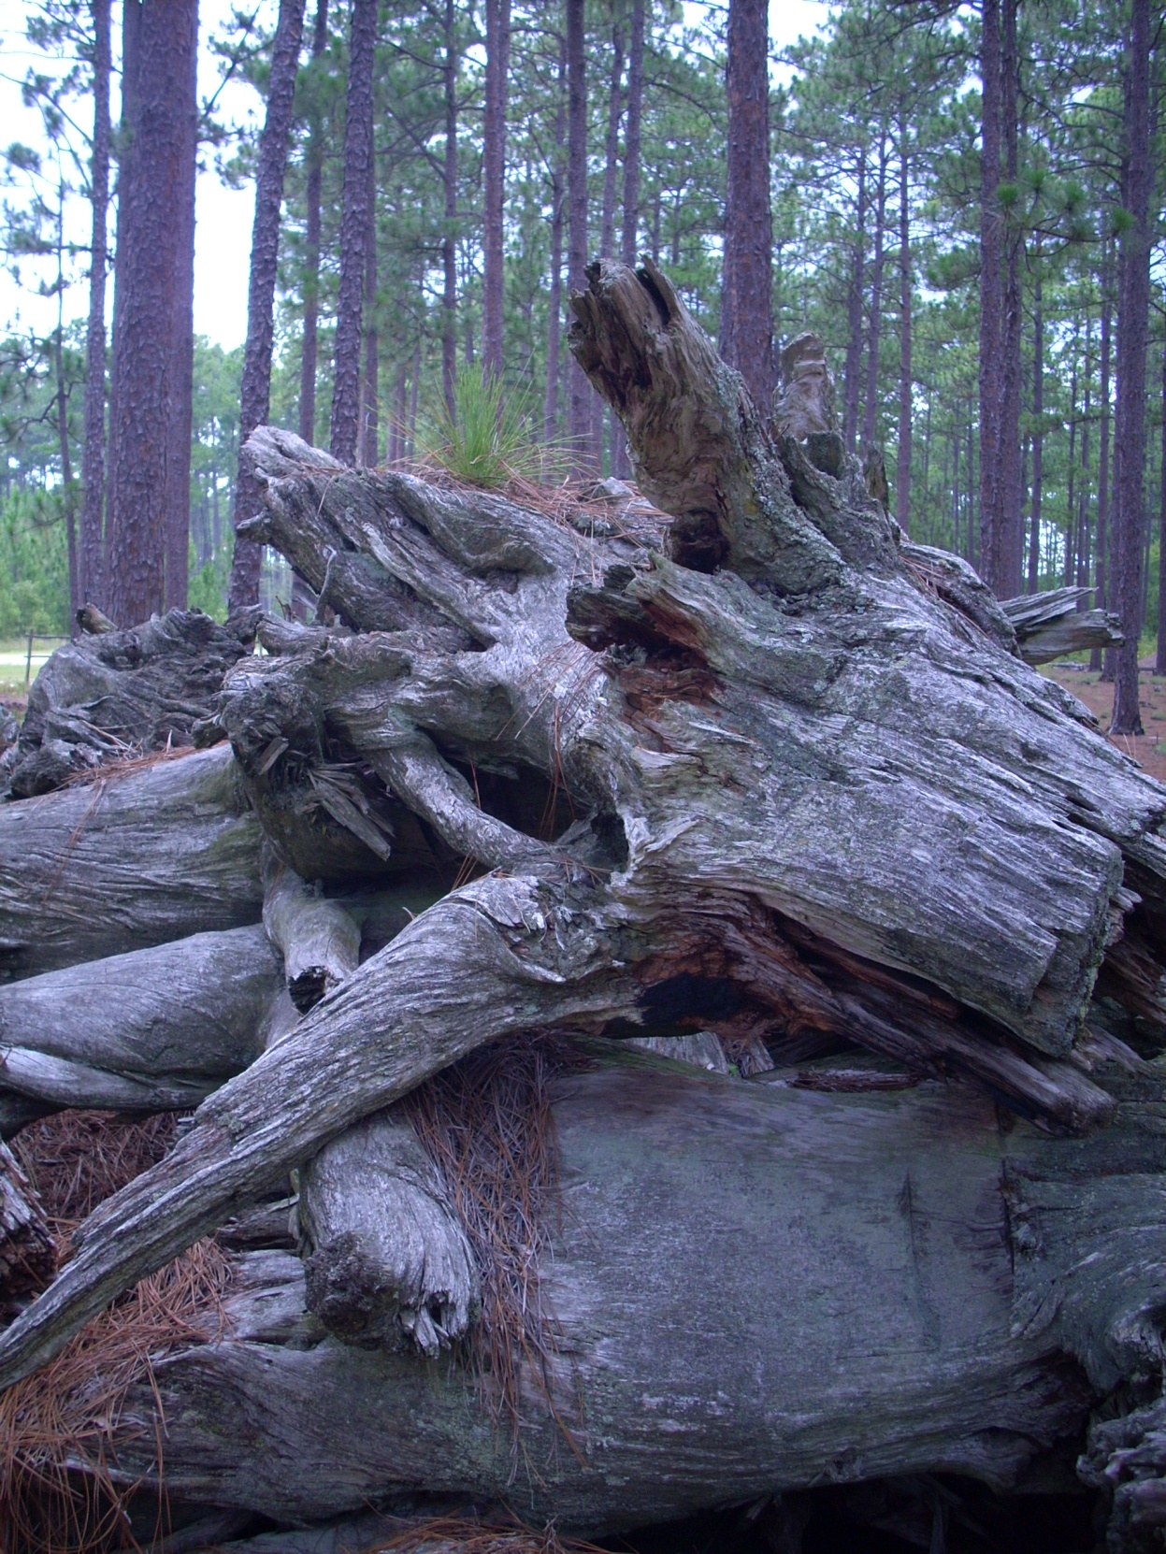
The End

