Slide 1
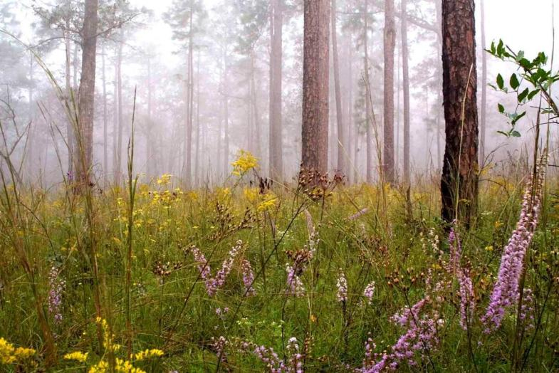
The Basics of Longleaf Understory Establishment & Enhancement

Slide 2
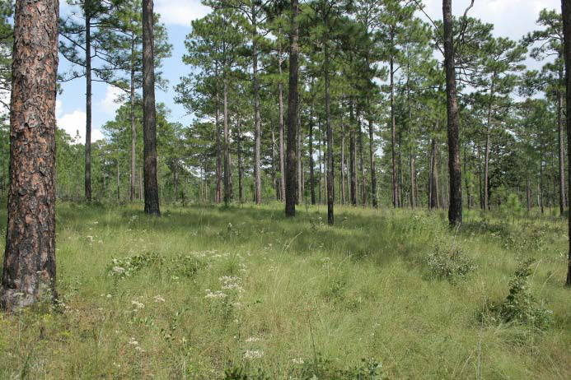
Longleaf Understory Benefits

Slide 3
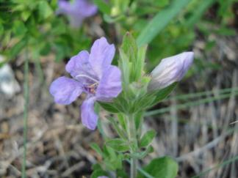
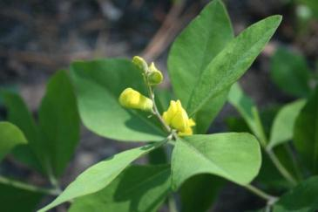
Plant Diversity
Frequently burned sites have higher species number at small spatial scales
Species Richness increases with higher soil moisture content
Composition varies across the region as well as across moisture gradients

Slide 4
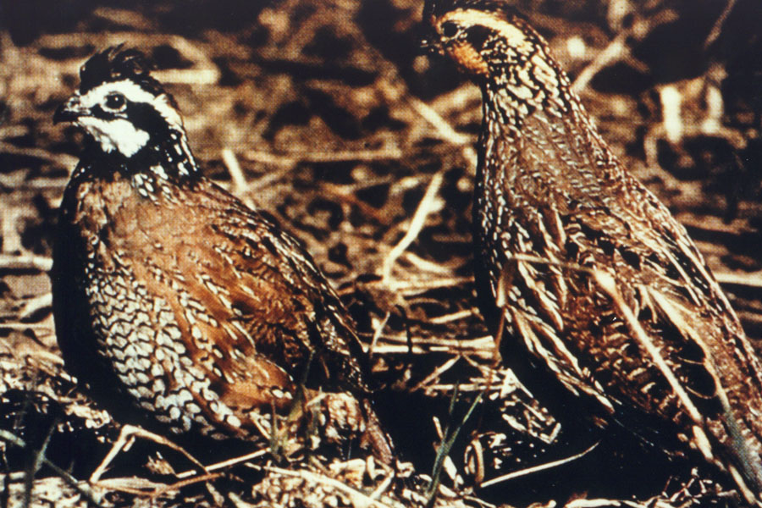
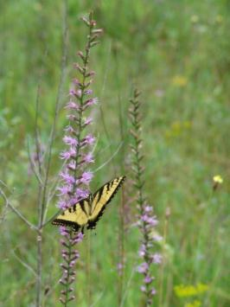
Wildlife Diversity
Higher wildlife diversity in early successional stage
Understory species provide both cover and food for many wildlife species
Gamebirds also thrive in herbaceous habitat
High quality understory contains many species that are beneficial to pollinators

Slide 5
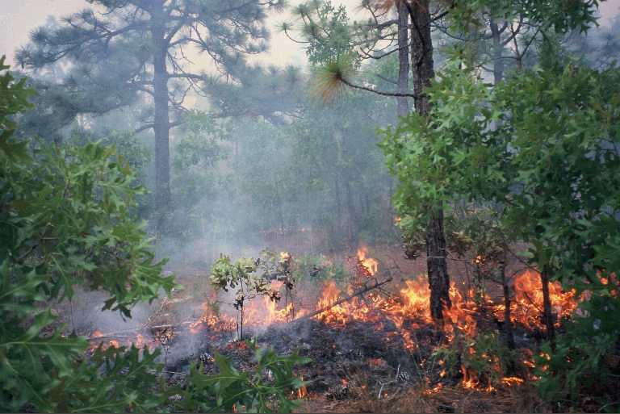
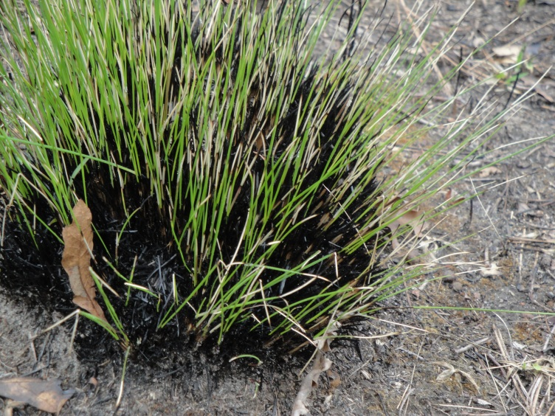
Fine Fuels
Understory species provide necessary fine fuels
Grasses are especially beneficial
Perennial species that are adapted to fire
Some species require fire for blooming and seed set

Slide 6
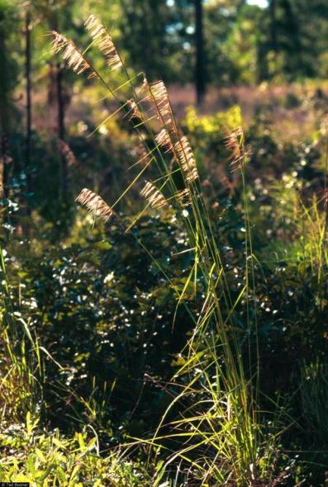
Longleaf Understory Components
Highest quality sites are maintained as early successional habitats with regular fire intervals
Largest plant families represented are grasses, legumes, and composites

Slide 7
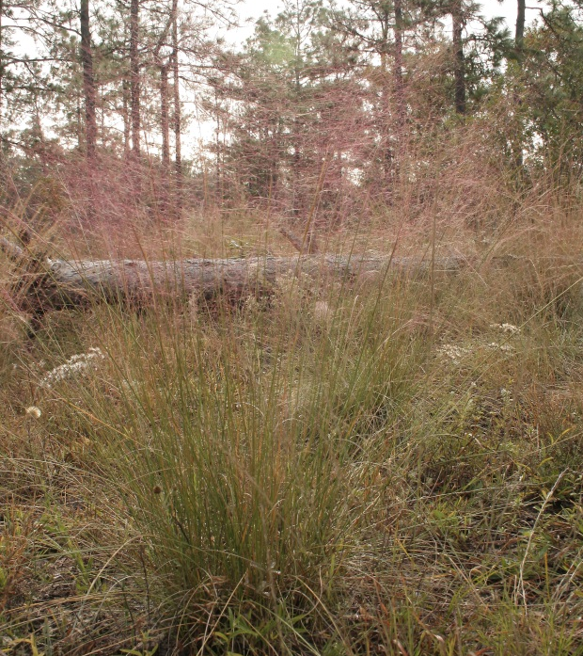
Native Warm Season Grasses

Slide 8
What is a Native Warm-Season Grass?
Active growth during spring and summer
Maximum growth at 60°F and soil temperatures of 55°F
Optimum temperatures for seed production - 85-95°F
C4 grass (higher photosynthetic potential compared to C3)
Can withstand harsh environmental conditions (drought, high temperatures, etc.)
Notes:
Dominant in longleaf pine and tall grass prairie ecosystems, and old fields in the south
Maximum growth when daily temperatures reach 60 and soil temperatures reach 55.
C4 grasses - fix energy into 4 carbon units resulting in higher photosynthetic potential
Minimize water loss during drought

Slide 9
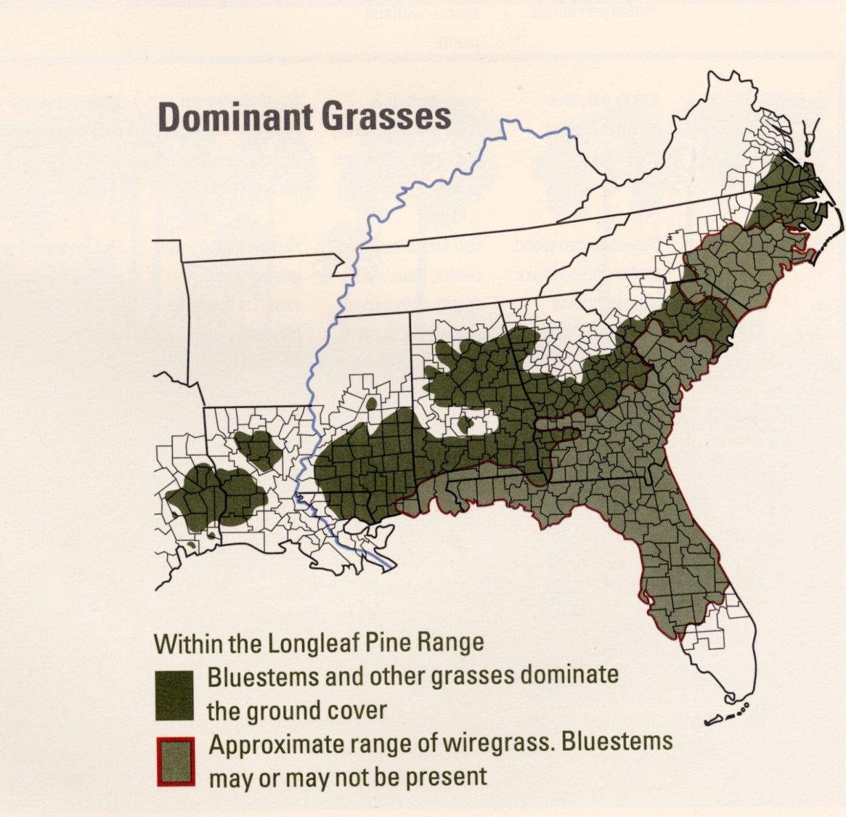

Slide 10
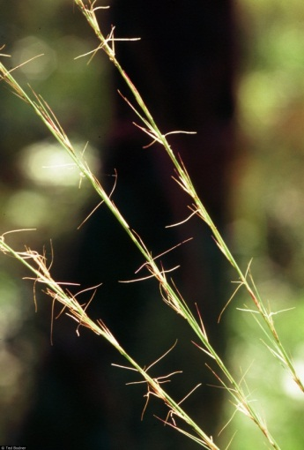
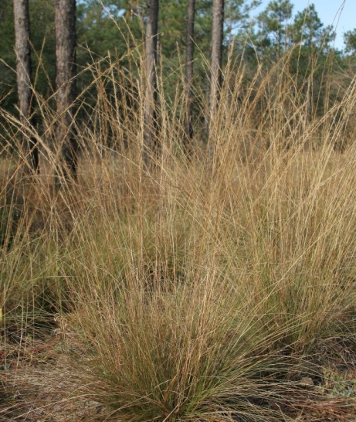
Wiregrass
Aristida stricta/beyrichiana
Identifying Characteristic: densely tufted bunchgrass, seeds bear 3 hair-like awns, leaves with tuft of hair near the base
Habitat: pine savannas and flatwoods
Wildlife Usage: provides nesting sites for quail, provides cover and forage for gopher tortoises and seeds are occasionally consumed by songbirds.

Slide 11
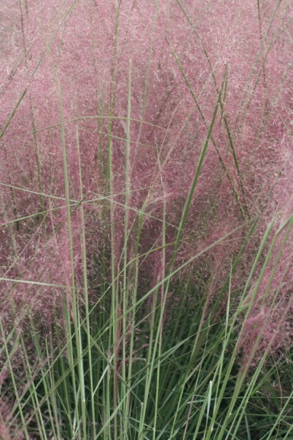
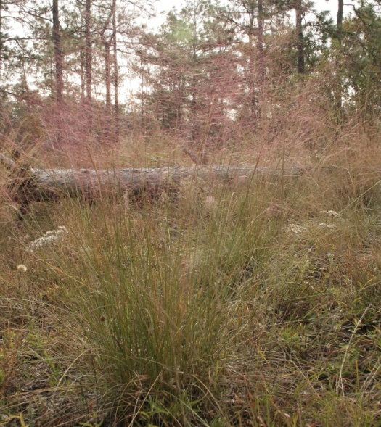
Muhly Grass
Muhlenbergia capillaris
Identifying Characteristic: bunchgrass with wiry leaves, open panicle of inflorescence is purple in color.
Habitat: grows in a range of habitats including seepage slopes, sand dunes, pine savannas, and flatwoods.
Wildlife Usage: provides cover for wildlife, seeds eaten by birds.

Slide 12
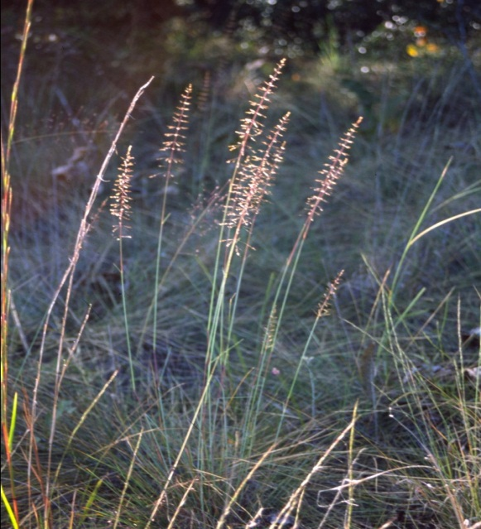
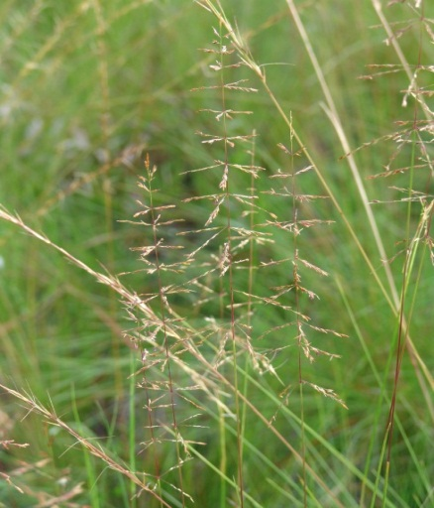
Pineywoods Dropseed
Sporobolus junceus
Identifying Characteristic: bunchgrass with wiry leaves, leaves are a blue/green color, inflorescence is pyramid shaped panicle.
Habitat: found in open dry sites in pine savannas, flatwoods, and sandhills.
Wildlife Usage: seeds consumed by songbirds, provides cover, foliage eaten by deer.

Slide 13
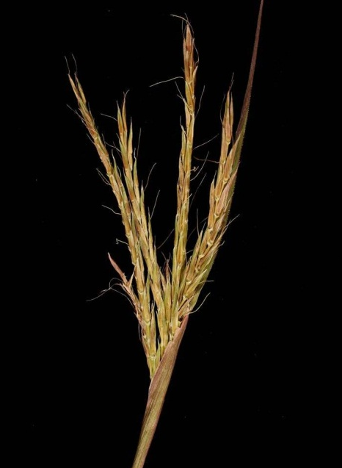
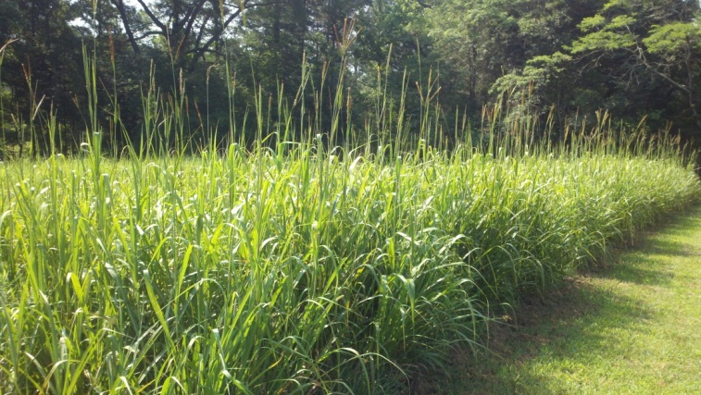
Big Bluestem
Andropogon gerardii
Identifying Characteristic: large bunch grass up to 8’ tall, brown inflorescence resembling a turkey foot
Habitat: common in prairies, hillside bogs, pine savannas, and flatwoods.
Wildlife Usage: provides good cover and nesting sites, seeds eaten by gamebirds and songbirds, foliage eaten by deer.

Slide 14
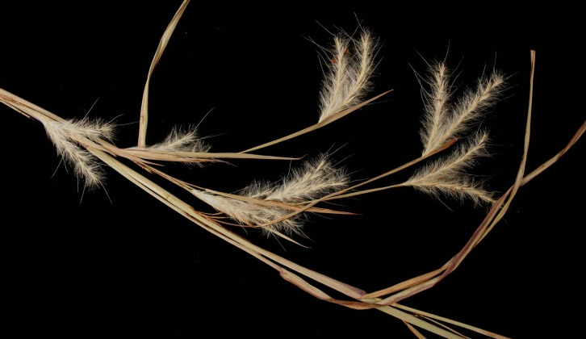
Splitbeard Bluestem
Andropogon ternarius
Identifying Characteristic: long inflorescence stalks up to 2” in length
Habitat: found in dry, sandy soils
Wildlife Usage: seed eaten by songbirds and quail, cover and forage for wildlife.
Splitbeard Bluestem

Slide 15
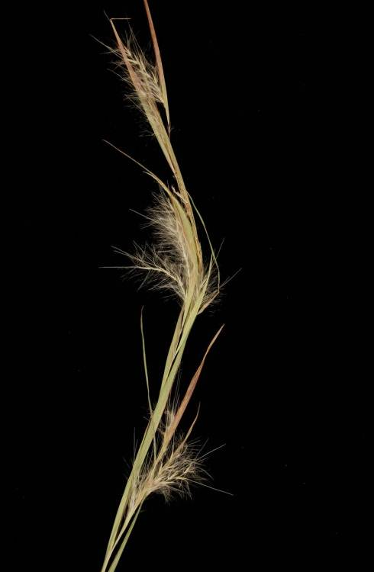
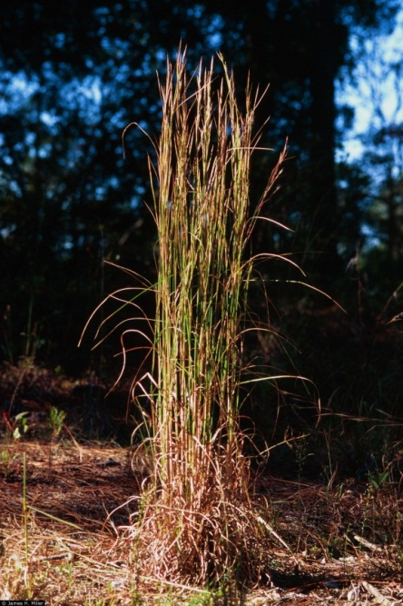
Broomsedge
Andropogon virginicus
Identifying Characteristic: common bunch grass up to 4’ tall, leaves flattened at the base, inflorescence with 2-4 racemes
Habitat: grows in a wide variety of habitats including grasslands, pastures, and open forests.
Wildlife Usage: provides good cover and nesting sites, seeds eaten by small mammals and songbirds.

Slide 16
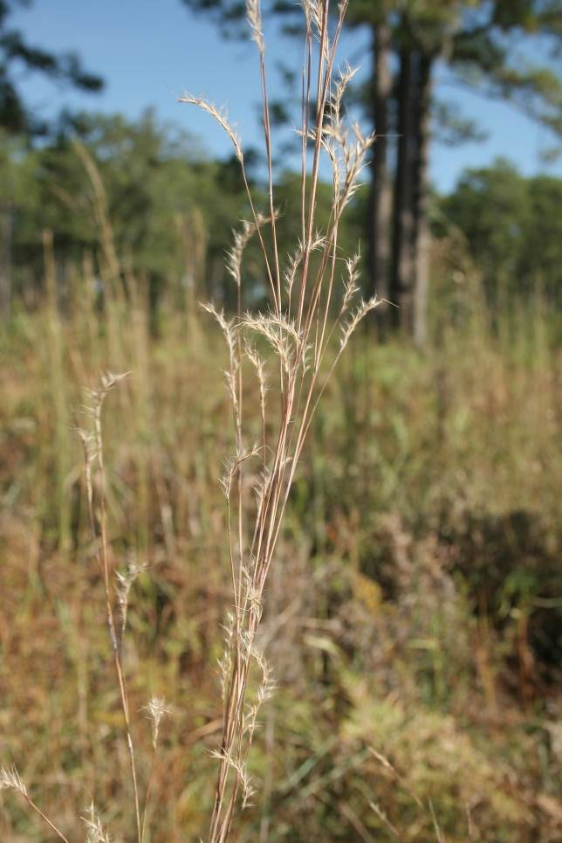
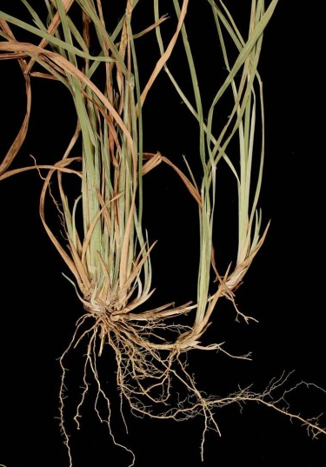
Little Bluestem
Schizachyrium scoparium
Identifying Characteristic: common bunch grass up to 4’ tall, inflorescence a single raceme, leaves turn purplish-red in fall.
Habitat: grows well in wide variety of habitats including old fields, open forests, and prairies.
Wildlife Usage: provides good cover for birds and small mammals, seeds eaten by birds.

Slide 17
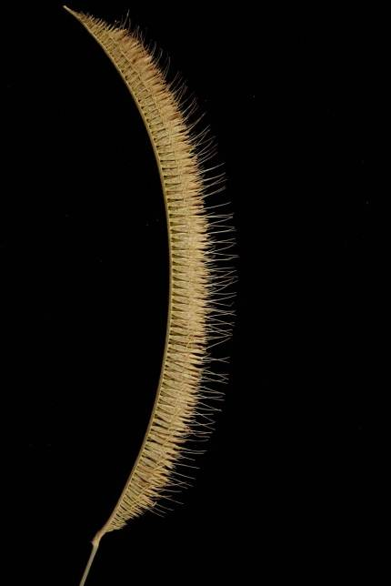
Toothache Grass
Ctenium aromaticum
Identifying Characteristic: bunch grass that forms dense clumps, leaves dark green on top and lighter on bottom, inflorescence looks like comb and curl as seeds mature
Habitat: found in wet to moist pine flatwoods, savannas, prairies, and pitcher plant bogs
Wildlife Usage: provides cover.

Slide 18
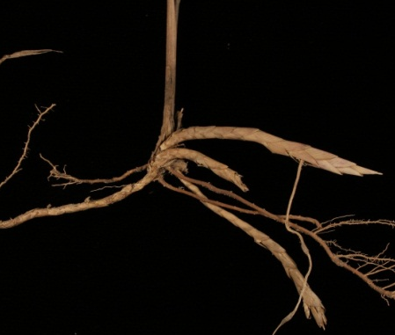
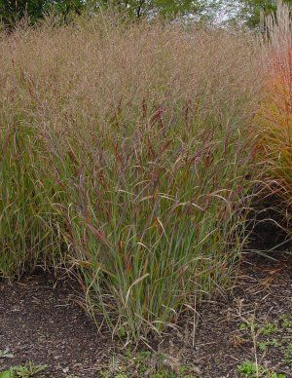
Switchgrass
Panicum virgatum
Ligule
Rhizome
Identifying Characteristic: rhizomatous grass up to 6 ft., open panicle inflorescence, ligule of dense hairs up to ¼” long
Habitat: grows in a variety of habitat types but prefers wet-mesic to mesic soil conditions
Wildlife Usage: seeds eaten by wild turkeys, quail, and songbirds, provides cover.

Slide 19
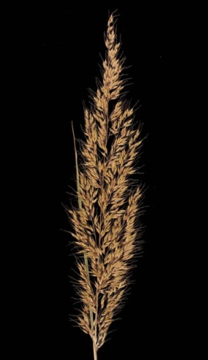
Yellow Indiangrass
Sorghastrum nutans
Awn
Identifying Characteristic: membranous ligule up to ¼” long, rhizomatous , long awns on spikelets
Habitat: grows well in plantations, open forests, forest margins, and right-of-ways.
Wildlife Usage: seeds eaten by songbirds and small mammals; cover for wildlife; foliage eaten by deer.
Ligule

Slide 20
Lopsided Indiangrass
Sorghastrum secundum
Identifying Characteristic: membranous ligule up to 1/8” long, non-rhizomatous clump grass, inflorescence a one-sided panicle, spikelets with long, twisted awns
Habitat: grows well in well-drained soils of upland sites.
Wildlife Usage: seeds eaten by songbirds and small mammals; cover for wildlife

Slide 21
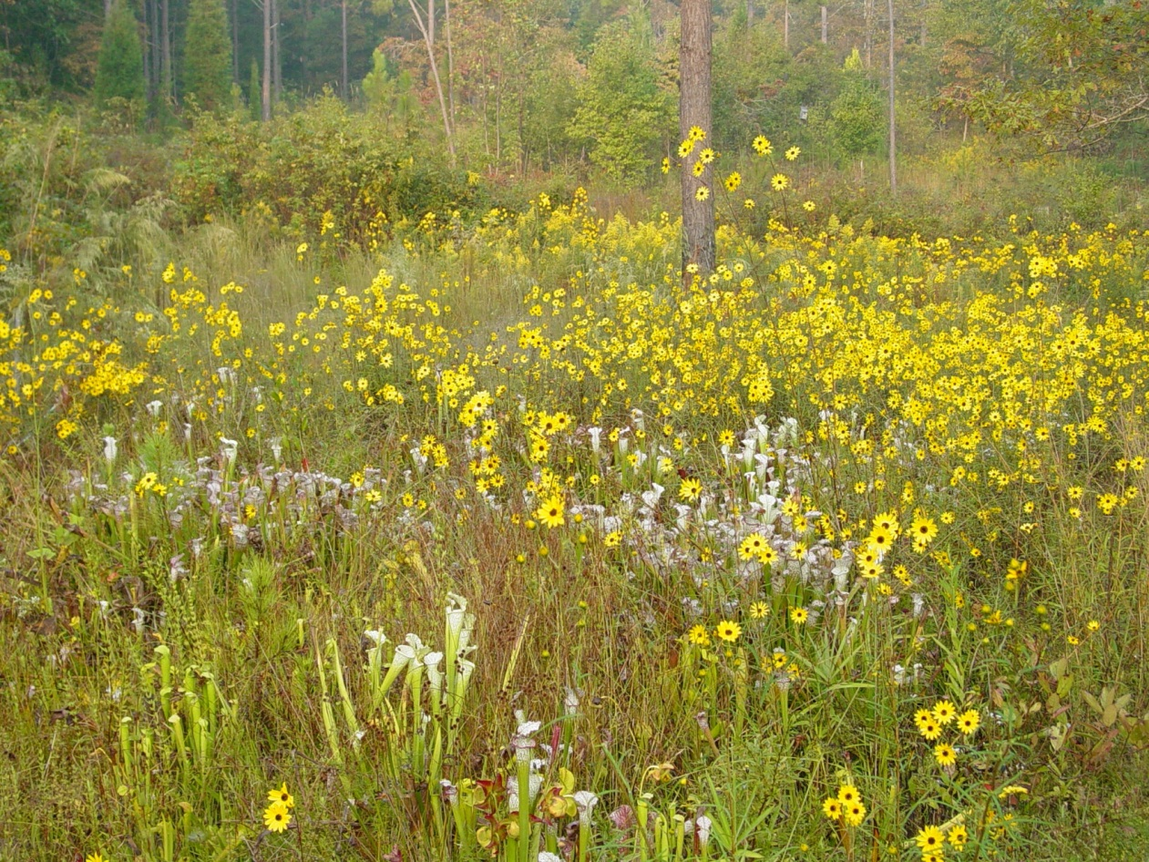
Composites

Slide 22
Asteraceae
Sunflower or Composite Family
One of the largest flowering plant families (~1100 genera & 19,000 species)
Many well adapted to all climates
Found from xeric to wet-mesic sites within the longleaf ecosystem
Characterized by flowers arranged in a head subtended by bracts
High pollinator value

Slide 23
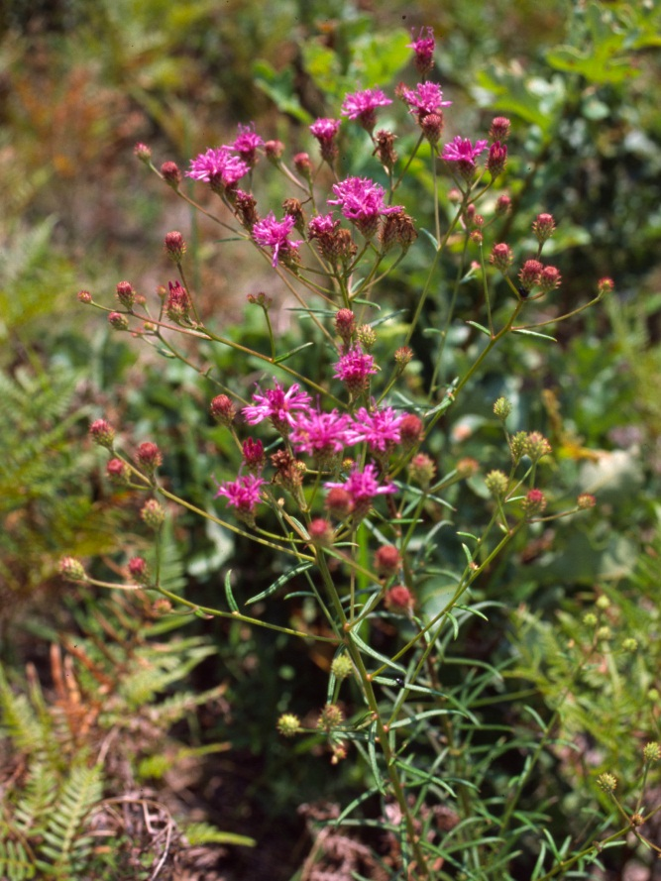
Tall Ironweed
Vernonia angustifolia
Identifying Characteristic: vibrant purple discoid inflorescence, alternate narrow leaves with deeply incised midvein.
Habitat: inhabits dry soils in longleaf pinelands and pine savannas.
Wildlife Usage: songbirds eat seeds, provides browse for deer, good pollinator plant.

Slide 24
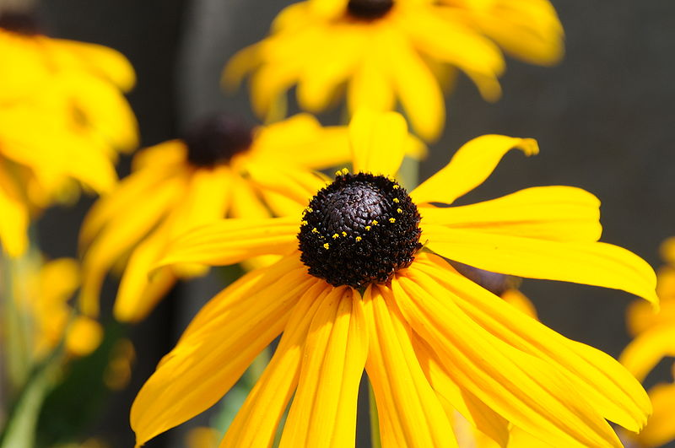
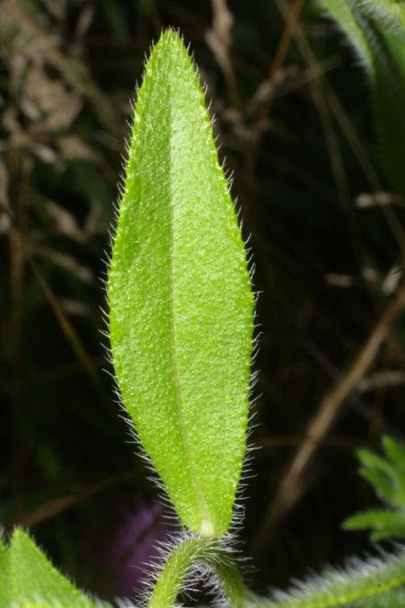
Brown-eyed Susan
Rudbeckia hirta
Identifying Characteristic: large, bright yellow flower heads, stems & leaves covered with rough hairs
Habitat: found in plantations, open forests, forest openings, and right-of-ways.
Wildlife Usage: songbirds eat seeds, deer browse foliage.

Slide 25
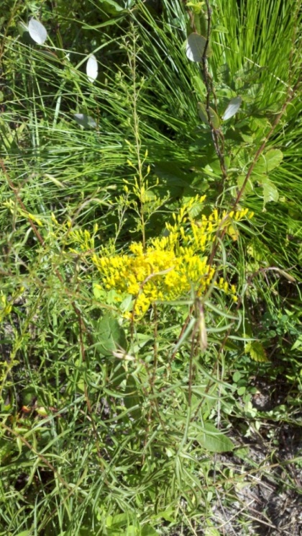
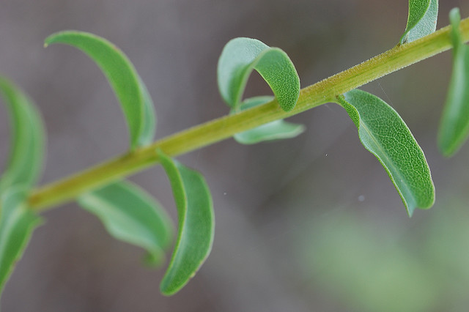
Anise-Scented Goldenrod
Solidago odora
Identifying Characteristic: late summer yellow flowers, leaves smell like licorice when crushed.
Habitat: common in open forests, along forest margins and right-of-ways.
Wildlife Usage: seeds consumed by small mammals & songbirds, leaves provide browse, and is good pollinator food source.

Slide 26
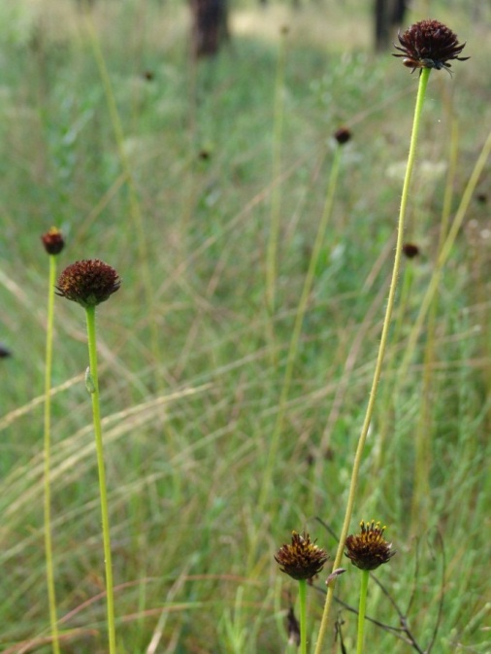
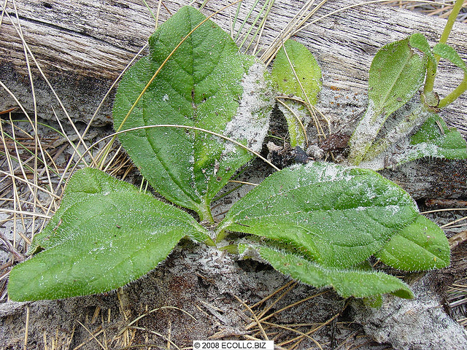
Rayless Sunflower
Helianthus radula
Identifying Characteristic: rough, basal leaves that run along ground, dark maroon/brown flower heads, heads with no ray flowers or much reduced.
Habitat: pine flatwoods, savannas, and pine barrens
Wildlife Usage: seeds consumed by small songbirds and is good pollinator food source.

Slide 27
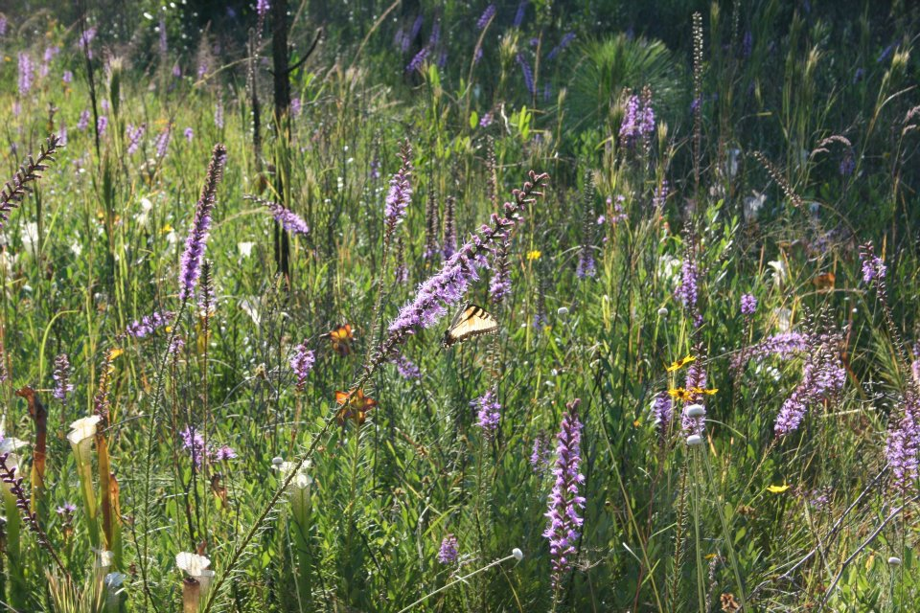
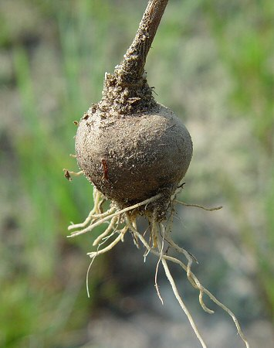
Spiked Blazing Star
Liatris spicata
Identifying Characteristic: rose-purple flowers arranged in a spike on slender plants reaching 5’ in height; tuberous root.
Habitat: found in forests openings, bogs, and meadows growing on mesic-wet soils.
Wildlife Usage: songbirds eat seeds, provides browse for deer, good pollinator plant.

Slide 28
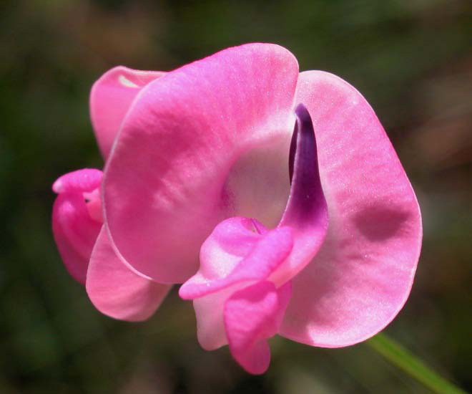
Legumes

Slide 29
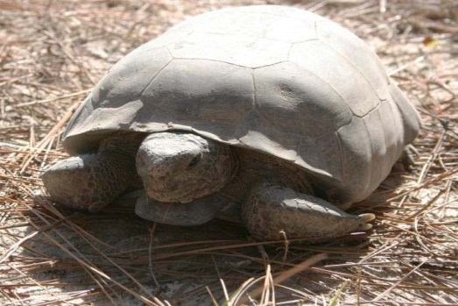
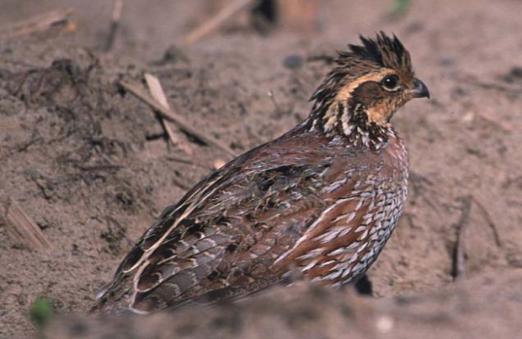
Importance of Legumes
Important contributors to the overall diversity of the longleaf pine ecosystem
Foliage of legumes is preferred forage for white-tailed deer, gopher tortoises, rabbits, and pocket gophers
Seeds are a component of the diets of bobwhite quail, wild turkey, small mammals, and seed-eating songbirds
Legumes can convert atmospheric nitrogen into forms usable by plants

Slide 30
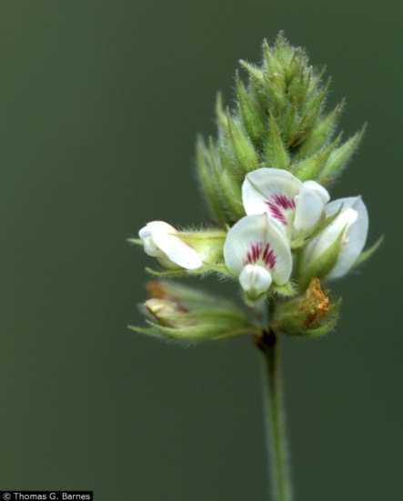
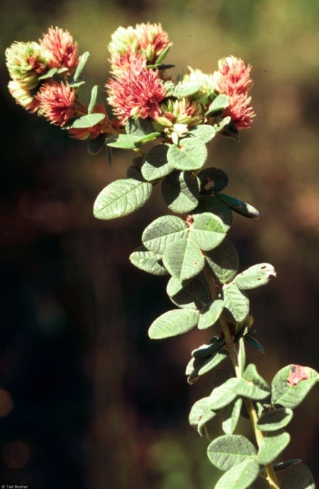
Hairy Lespedeza
Lespedeza hirta
Identifying Characteristic: erect plant covered with silvery hairs, leaves oval shaped, white to pale yellow flowers
Habitat: grows in forest openings, old fields, and right-of-ways.
Wildlife Usage: seeds eaten by quail, dove, & wild turkey and foliage is eaten by deer and gopher tortoises

Slide 31
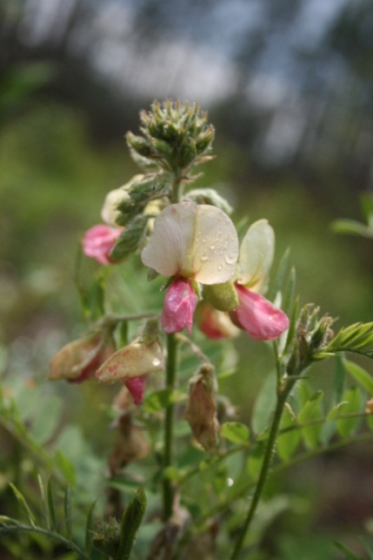
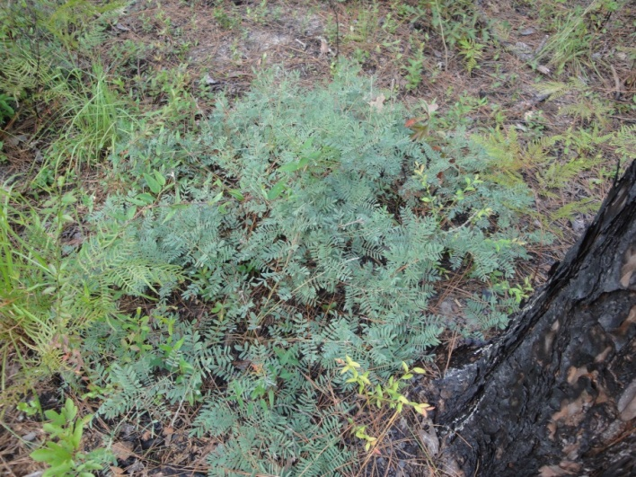
Goat’s Rue
Tephrosia virginiana
Identifying Characteristic: pinnately compound leaf, bicolored flower, clonal, erect growth
Habitat: found in open forests, fields, and right-of-ways on dry sandy soils.
Wildlife Usage: seeds of Tephrosia are eaten by quail and other seed-eating songbirds; foliage is eaten by deer & gopher tortoises; good cover plant

Slide 32
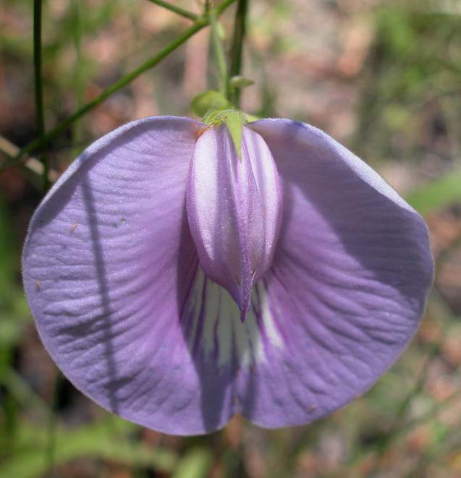
Spurred Butterfly Pea
Centrosema virginianum
Identifying Characteristic: twining or trailing vine, large 1” purple flowers with spreading petals
Habitat: found in mesic, open woods
Wildlife Usage: seeds eaten by quail and other songbirds; foliage eaten by deer and gopher tortoises

Slide 33
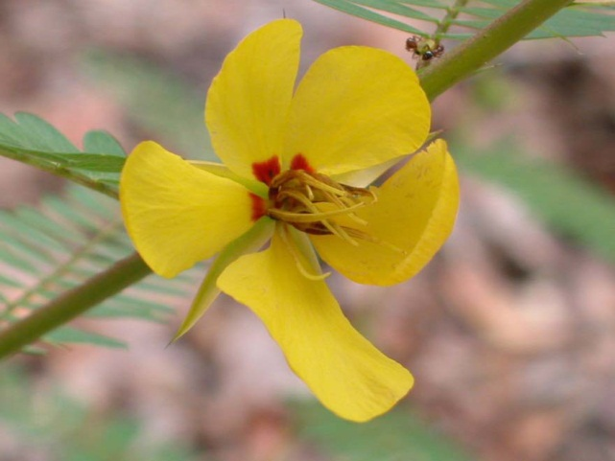
Partridge Pea
Chamaecrista fasciculata
Identifying Characteristic: large yellow flowers with red centers, branched erect annual up to 3’, small flat gland at the base of the petiole
Habitat: commonly found in plantations, roadsides, old fields, and open forests.
Wildlife Usage: seeds eaten by quail, wild turkey, and small mammals; foliage is eaten by deer and gopher tortoises; host plant for butterfly larvae.

Slide 34
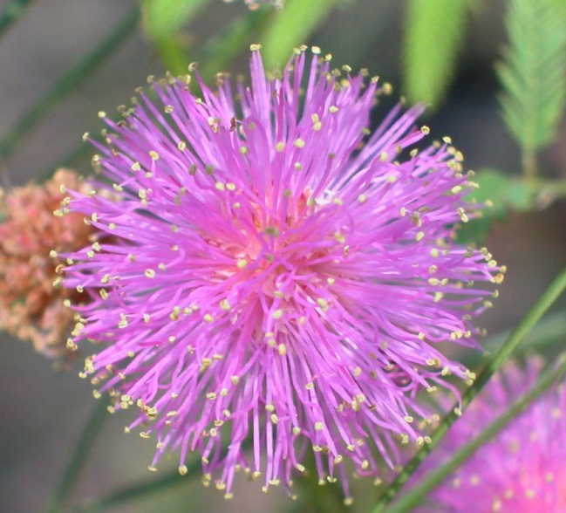
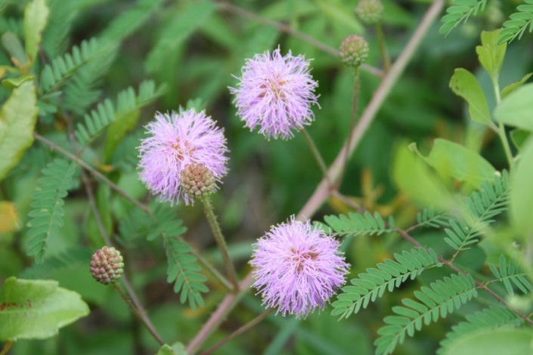
Sensitive Brier
Mimosa quadrivalvis
Identifying Characteristic: pink pom-pom flowers, thorny spreading plant, pinnately compound leaves, flowers look like Mimosa tree flowers
Habitat: open forests with dry, sandy soils
Wildlife Usage: seeds eaten by quail other songbirds, and gopher tortoises; foliage is eaten by gopher tortoises and wild turkeys

Slide 35
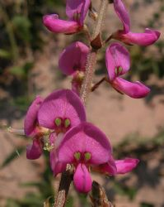
Florida Ticktrefoil
Desmodium floridanum
Identifying Characteristic: perennial herb that can reach 3’ in height; rough feel to the leaves and stem; fruit sticky
Habitat: grows in open forests
Wildlife Usage: seeds eaten by quail, dove, wild turkey, small mammals, and other songbirds; pollinator host plant; deer forage.

Slide 36
Understory Restoration Process

Slide 37
Developing a Restoration Plan
Identify degradation factors
Define goals & objectives
Identify reference community
Determine necessary restoration activities
Develop realistic restoration schedule

Slide 38
Determine Site Needs and Landowner Objectives
May not need extensive site preparation and planting if understory already occurs
More intensive prep required if invasives or other competitors are an issue
What plant species you plant depends on your objectives
Diversity
Wildlife
Pollinator Enhancement
CRP

Slide 39
Relationship between time and resources needed for restoration and the abundance of remnant biota on the site to be restored

Slide 40
Implementing a Restoration Project
Preparing the site for restoration
Managing competition
Increasing biodiversity and coverage of understory species
Monitoring

Slide 41
Preparing the Site
Key factors to address:
Soils
Hydrology
Light

Slide 42
Managing Competition
Take a botanical inventory
Use aggressive chemical treatments to manage invasive species
Mowing is an option for controlling some annual weeds
Woody competition can be controlled with fire, mechanical, and/or chemical treatments

Slide 43
Increasing Biodiversity
Reintroduction of fire can increase understory plant diversity in some sites
When no understory exists, site must be supplemented with plant material

Slide 44
Plant Material Sources
Obtain material from:
Commercial producers
State nurseries
Donor sites
Planting options:
Live Material (plugs)
Seed Material
Best to look for ecotype seed/plants that are locally sourced

Slide 46
Planting Live Material
Target density for most species is ~3 plants/m²
Can be planted by hand or with mechanical tree planter equipment

Slide 47
Planting Seed Material
Need good seed to soil contact
Plant no more than ¼ inch deep
Seeding Methods
Seed Drills
Grasslander is used for seed collected with seed stripper (Bulk Seed)
Tru-Ax drill is used with clean seed (Pure Live Seed)
Broadcast seeding
Disked sites must be compacted prior to and following seeding
Use a carrier

Slide 48
Seeding/Planting Rates
Widely variable among restoration practitioners
Seed sowing rates
Seed drill: 15-60 PLS seeds/ft²
Broadcast: 10-20 lbs bulk seed/acre
Plug planting density
Varies by species
Wiregrass: 2000-4000 plugs/acre
Notes:
Targeting ~ 3 plants/ m2 - .5-1.5 lbs wiregrass/acre is sufficient

Slide 49
Monitoring the Site
Monitoring is essential to determining the success of a restoration project
Photomonitoring can be used to measure qualitative change from year to year
Vegetation monitoring can be used to measure vegetation change over time

Slide 50
Restoration Scenarios

Slide 51
Old field site
Current Conditions: little to no existing desired understory, no canopy
Goal: establish understory in order to reintroduce fire for site management; establish longleaf canopy
Site Prep: multiple chemical treatments; disk & cultipack prior to seeding
Understory Treatment: sow basic seed mix using grain drill
Management: spot chemical treatment; fire

Slide 52
Old Field Seed Mix
Native Warm Season Grasses
Big Bluestem (Andropogon gerardii) 1.5 lbs/ac
Indiangrass (Sorghastrum nutans) 1.5 lbs/ac
Little Bluestem (Schizachyrium scoparium) 1.5 lbs/ac
Forbs
Partridge Pea (Chamaecrista fasciculata) 0.25lb/ac
Native Lespedeza (Lespedeza spp.) 1.0 lb/ac
Florida Ticktrefoil(Desmodium floridanum) 1.0 lb/ac

Slide 53
Plantation Site
Current Conditions: 18 year old longleaf plantation recently thinned; widely scattered native understory present; no invasives present
Goal: manage site for timber and wildlife; enhance existing understory and supplement with desirable species
Site Prep: prescribed burn prior to planting seed
Understory Treatment: sow understory species with seed drill
Management: fire

Slide 54
Plantation Site Seed Mix
Grasses Rate (lb/ac)
Little Bluestem 1.5
Splitbeard Bluestem 1.15
Lopsided Indiangrass .5
Sporobolus junceus .25
Muhly Grass .50
Toothache Grass .25
Wiregrass .10
Fall Panicum .25
TOTAL 4.5 lbs/ac
Forbs Rate (lb/ac)
Partridge Pea 1.5
Florida Ticktrefoil 1.15
Sensitive Brier .5
Spurred Butterflypea .25
Spiked Blazingstar .50
Lespedeza sp. .25
TOTAL 1lb/ac

Slide 55
Forested Site
Current Conditions: Mature longleaf forest with altered fire regime; thick midstory of hardwoods; understory impacted by shade
Goals: Restore regular fire regime; enhance wildlife populations, enhance plant diversity
Site Prep: Burn if possible; alternatively use mechanical and/or chemical treatments to remove midstory; follow with regular fire.
Understory Treatment: Supplemental planting not necessary if understory rebounds; augment site with rare species or wiregrass if desired
Management: Use prescribed fire at 2-5 year intervals
Notes:
Hexazinone/garlon chemical treatments

Slide 56
Forested Site Enhancement
Regular burns will continue to enhance understory diversity
Wiregrass seed planted with seed drill in open forest patches (.5 lb/ac)

Slide 57
Resources
Seed Sources:
Roundstone Native Seed – www.roundstoneseed.com
Ernst Conservation Seed – www.ernstseed.com
Lolly Creek – www.lollycreek.com
Southern Habitats – www.southernhabitats.com
The Natives – www.thenatives.net
State Nurseries
Technical Advice:
The Longleaf Alliance – www.longleafalliance.org
State Agencies (Forestry Commission, DNR, Wildlife Resource Commission, etc…)
Manuals:
Groundcover restoration in forests of the Southeastern United States. CREOR Research Report 2009-01.
Groundcover Restoration Implementation Guidebook. Florida Fish & Wildlife Conservation Commission.

Slide 58
Questions?
carol@longleafalliance.org
678.595.6405

