Slide 1
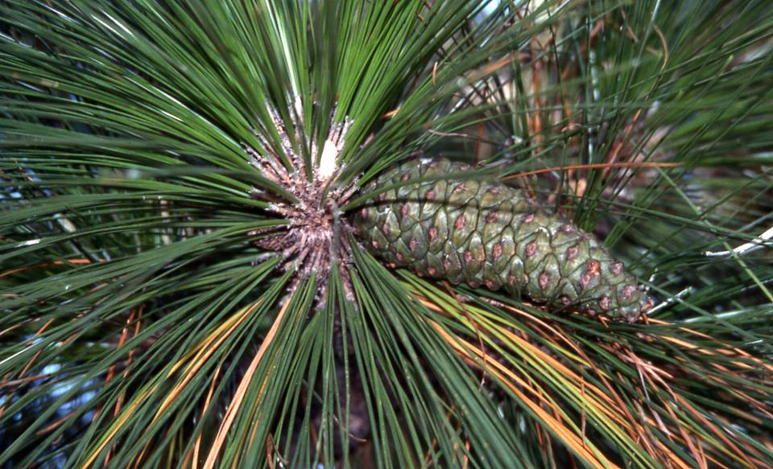
Managing Longleaf Pine for Wildlife
Brady Beck
NCWRC

Slide 2
Why Longleaf Pine?
Only 3% of original range is still Longleaf http://www.longleafalliance.org/ecosystem/maptoday.htm
Ecosystem supports a whole suite of species that occur nowhere else
Probably more important than the Longleaf trees themselves, the wiregrass/forb groundcover is under increasing pressure due to conversion, fire suppression, development, canopy closure…
More resistant to Southern Pine Beetle attacks than Loblolly (Important
in a fire maintained ecosystem)
Longleaf pine & associated species are a State Wildlife Action Plan priority

Slide 3
NC’s Wildlife Action Plan
Provides information on the state of our wildlife resources
Identifies priority species and habitats
Identifies strategies and priorities for conservation work
Stresses opportunities for collaboration

Slide 4
Overall Management Goals
Thin pine stands to allow sunlight to hit forest floor
Prescribed Burn
Encourage native grass and forb communities (fire, control competition,
reduce closed canopy situations)
Minimize soil disturbance in site prep operations
Encourage natural regeneration where possible (less soil disturbance,
cheaper, no site prep)
Growing season burns promote natural regeneration of Longleaf
Maintain early successional openings through burning, mowing, or
plantings

Slide 5
Thin and Burn

Slide 6
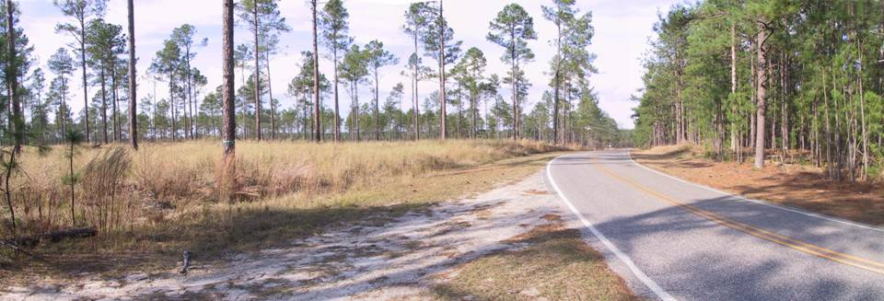
Left side was thinned to about 25 ft², planted with Warm Season Grass, and
burned several times. Winter 2002
Summer 2009-- both sides thinned and burned

Slide 7
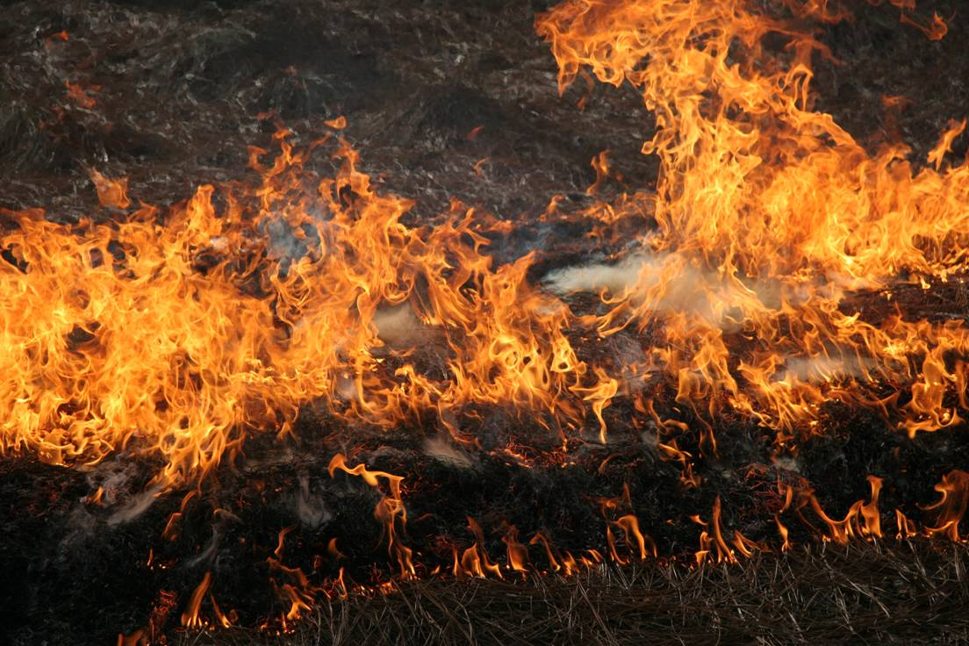
Prescribed Fire
Burn stands on a 2-5 year rotation
Reduce fuels with dormant season fires before attempting growing season burns
Time burns to fuel conditions as well as desired effect
Growing season burns result in more vigorous plant response and more diverse groundcover, but may incur some initial tree mortality
Vary burn block size and location so there are burned and unburned areas adjacent to one another

Slide 8
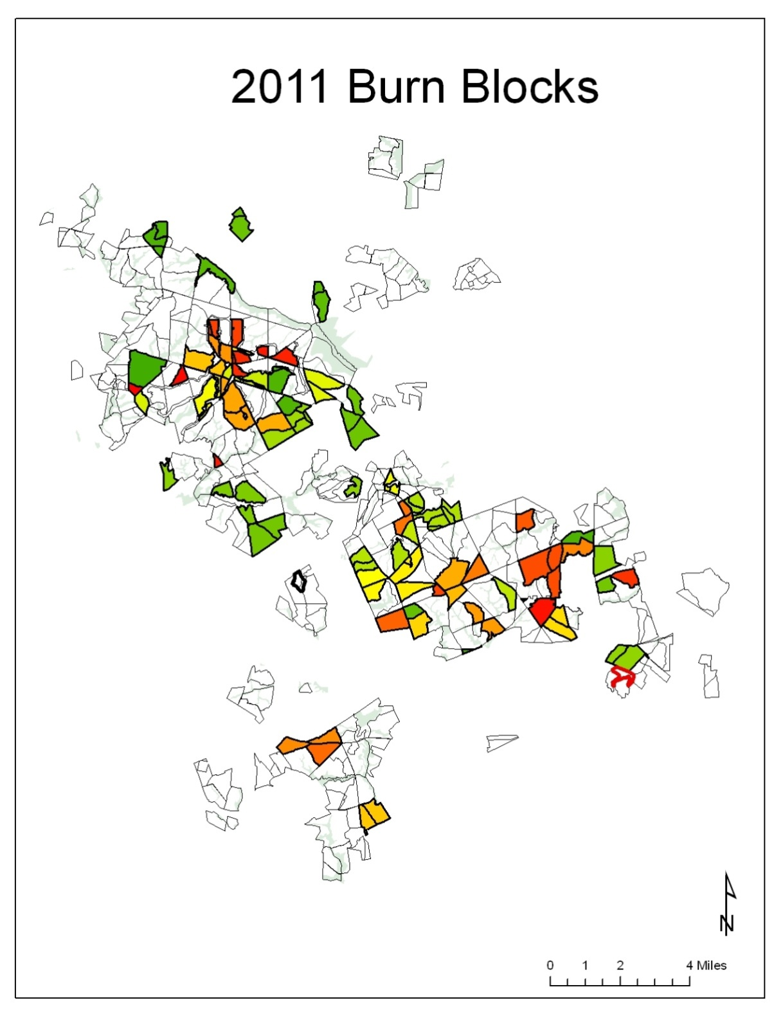
Burn Map
Prescribed fire is the main
tool the WRC uses to reduce
fuels, and improve wildlife
habitat for all of the species
we are going to talk about
Burn units are spread out over
the GL so that unburned habitat
is present throughout the year

Slide 9
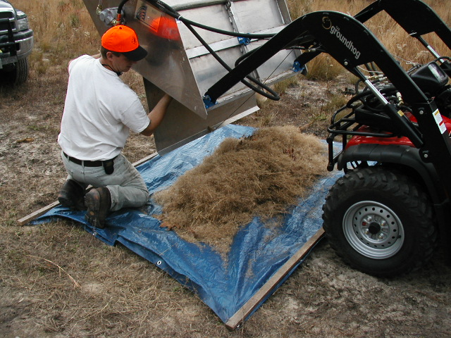
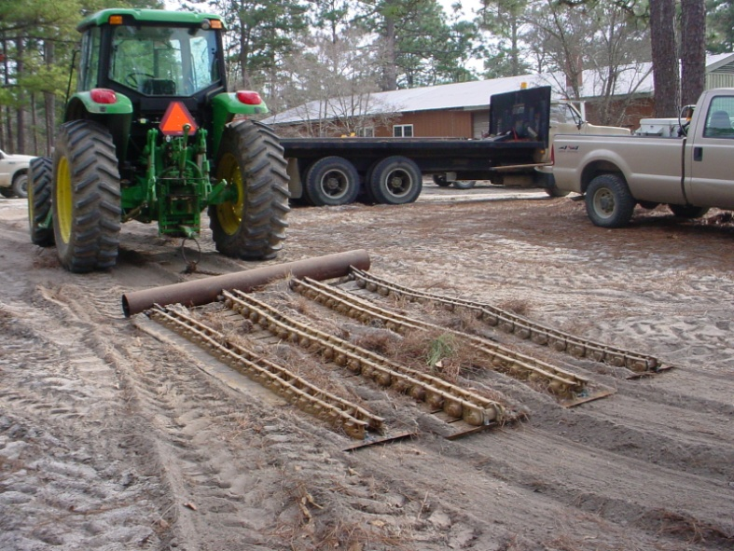
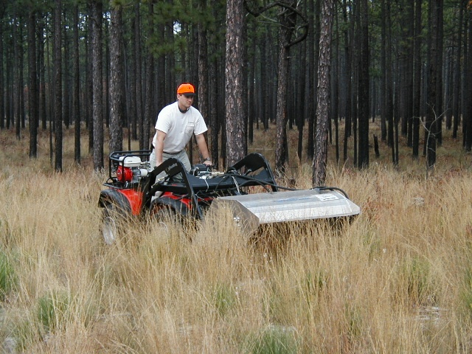
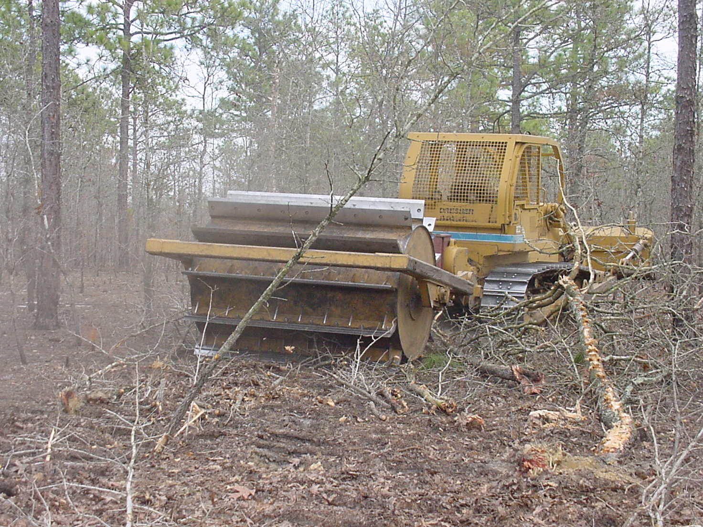
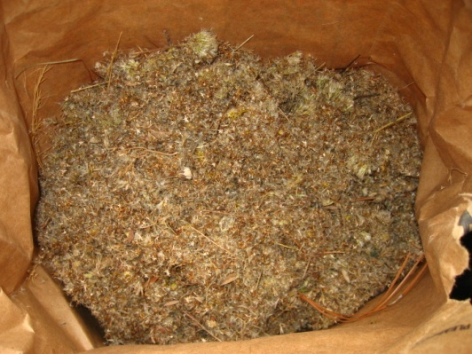
Groundcover Restoration

Slide 10
Herbicide Use
This stand was treated with Velpar ULW and then burned
The resulting grass response benefits many species of wildlife
Herbicides can be useful tools for
controlling undesirable vegetation and allowing more
sunlight to reach the forest floor
Care should be taken to avoid treatment of sensitive
plant locations

Slide 11
Snag Management
Maintain as many snags on the landscape as possible
Birds such as woodpeckers, nuthatches, owls, kestrels, and bluebirds
benefit from good snag mgt.
Several species of snakes live under the bark of dead pines
Snags provide nesting and foraging opportunities
Most burn programs create snags, they also can get burned up in
prescribed burns

Slide 12
Quail
Keep as much of ground in direct sunlight as possible
Control plant succession to maintain diversity of grasses and forbs in understory
Control hardwood invasion-competition
Fire is important to maintain ground cover, forb diversity, and areas to forage on insects
Legumes are important food source for quail
Quail chicks need areas to forage for insects – young chicks need protein they get from the insects

Slide 13
Quail (Continued)
Want to establish and maintain openings in timber stand for quail (logging deck, skidder trails, Field borders, etc.)
Good habitat for 2-4 years following longleaf regeneration cuts
Longleaf pine is better suited for quail management than loblolly, slash, and shortleaf pine
Longleaf seed are highly nutritious and favored by quail
Prescribed fire applied in the winter months works well to establish suitable quail habitat in longleaf pine stands as well as stands of ragweed, partridge pea, and lespedeza
When grass becomes thick and matted, the areas should be burned to allow quail to scratch forage on the ground under the grass
Frequently burned streamhead pocosins can provide good nesting and
foraging habitat
Quality quail habitat will support one covey of 9-14 quail per 20 acres

Slide 14
White Tailed Deer
Prescribed fire will increase the forb and legume diversity in timber stands, which are good deer foods
Regeneration areas create good deer habitat by allowing sunlight to hit the ground and promote the growth of herbaceous foods that deer need
Regeneration areas that are thick can also provide good bedding areas for deer
Open areas in timber stands are good areas for food plots (logging decks, skidder trails, etc.)
Burning in late winter and early spring helps to promote native legumes and quick green up and relatively quick food sources for deer
Thinning stands to 50-60 square feet of basal area allows sunlight to hit the ground
Deer require much larger areas than the other game species mentioned, so
Landowners may have to convince their neighbors to manage in a similar fashion

Slide 15
Turkey
Pockets of mast producing oaks provide needed forage for turkeys
Open areas are needed for insect foraging chicks
High quality habitat will support 1 turkey per 30 acres and a flock of 18-20 turkeys per square mile
Turkeys forage on green leaves and grasses in the spring
In the summer and fall, preferred foods are berries, fruits, ripened seed heads and insects
Acorns are the most important food to turkeys in the winter

Slide 16
Fox Squirrel
Longleaf seeds are an important food source
Each cone can contain as many as 100 seeds totaling up to 5,000 calories
Cavity or leaf bunch nesters, so snags and old
pileated woodpecker cavities can provide
important nesting sites
Artificial nests (old tire type nests or wooden
boxes) are effective for improving nesting habitat
Maintain open stands (thin and burn) with diverse
groundcover and scattered hardwood mast producers
Important seed dispersers- they are scatter cachers

Slide 17
Reptiles and Amphibians
Manage upland pools for early successional conditions
Coarse/woody debris provides cover for herps
Rotting stumps create habitat for snakes and other reptiles and amphibians
Maintain and encourage as diverse a grass and forb groundcover layer as possible (growing season fire, open canopy)
Many frogs, salamanders, and snakes benefit from burned LL drains
Minimize soil compaction

Slide 18
Wildlife Action Plan – Reptiles and Amphibians that use Longleaf Pine
Eastern Tiger Salamander (T)
Oak Toad (SR)
Ornate Chorus Frog (SR)
Carolina Gopher Frog (T)
Eastern Diamondback Rattlesnake (E)
Southern Hog-nosed Snake (SC)
Eastern Coachwhip (SR)
Eastern Coral Snake (E)
Northern Pinesnake (SC)
Pigmy Rattlesnake (SC)

Slide 19
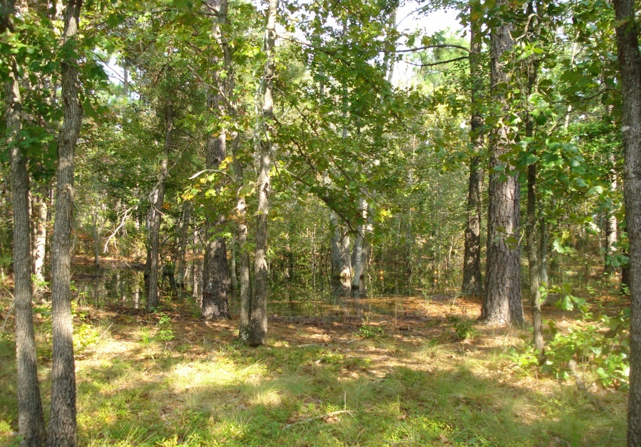
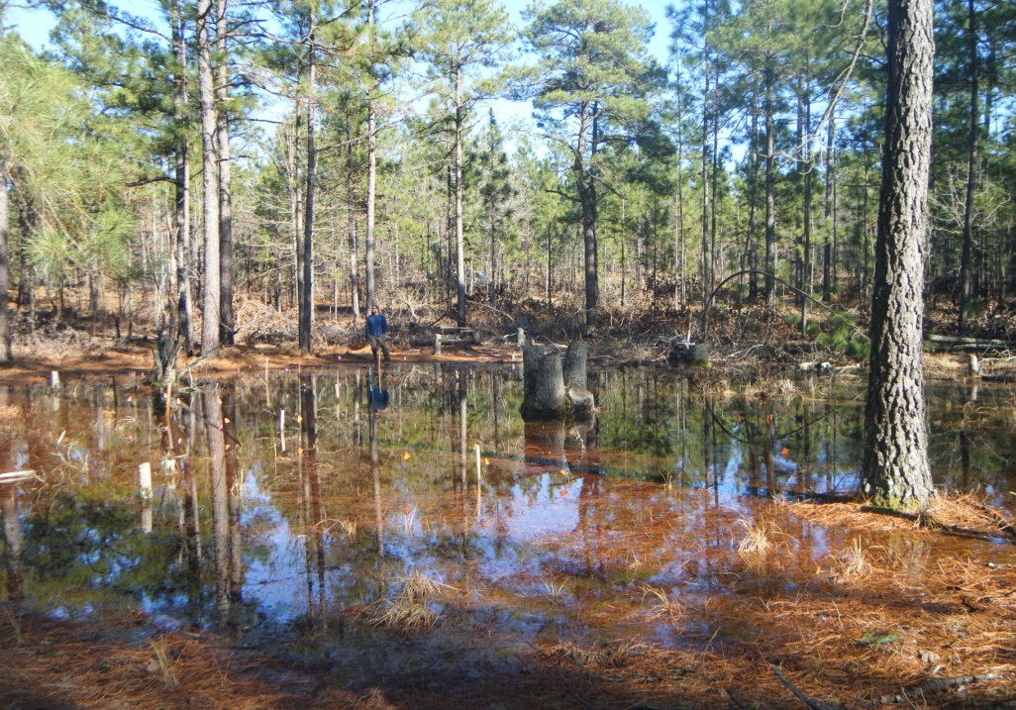
Seasonal Pond Restoration
Seasonally dry pond grown up in trees
The same pond in winter after tree removal.
Many rare frogs and salamanders depend on isolated wetlands for breeding. Historically, these seasonally dry ponds were kept free of trees by fire. Without fire, these habitats are invaded by woody vegetation, making them unsuitable for many of the species that depend on them. To restore these habitats, land managers must remove the invading hardwoods and reintroduce fire.

Slide 20
Red-Cockaded Woodpeckers (Federally Endangered)
Nest in old, live pine trees
Cavities take up to 12 years to complete
Require 60-500 acres of foraging habitat per group of birds
Good foraging habitat is typically at least 30 years old pine with a BA of 50-70, prefer older stands and larger trees
FWS guidelines suggest managing RCW habitat for at least 40% native grass/forb groundcover
Prescribe burn 2-5 year rotation
Control mid-story hardwoods (keep below 7’)
Provide artificial cavities where groups have fewer than 4 suitable cavities
Requires OLD (80+ yrs) stands for nesting habitat

Slide 21
Other Birds to consider
Large snag cavity nesters
Keep a few large diameter snags per acre
Screech owls, bluebirds, woodpeckers, nuthatches will all benefit
Grassland/shrubland nesters
Maintain some open shrubby fields

Slide 22
Bachman’s Sparrow (FSC)
Longleaf Pine- Wiregrass specialist
Ground nesters
Best habitat is year 1 and 2 after a burn
Brown Headed Nuthatch
Cavity nesters
They use small diameter snags, relatively close to the ground
Relatively easy to create habitat for them- keep some small snags on the landscape
Eat LL seeds

Slide 23
Wildlife Action Plan – Birds and Mammals that use Longleaf Pine
Bachman’s sparrow (SC)
Henslow’s Sparrow (SR)
Red-cockaded Woodpecker (E)
Eastern Fox Squirrel (SR)

Slide 24
Burn Baby Burn……

Slide 25
Additional Resources:
Longleaf Alliance http://www.longleafalliance.org/
USFWS RCW Recovery http://www.fws.gov/rcwrecovery/
USFWS Partners for Fish and Wildlife
http://www.fws.gov/southeast/partners/pfwpine.html
NC Wildlife Resources Commission- State Wildlife Action Plan
http://www.ncwildlife.org/plan/index.htm

